Slide 1
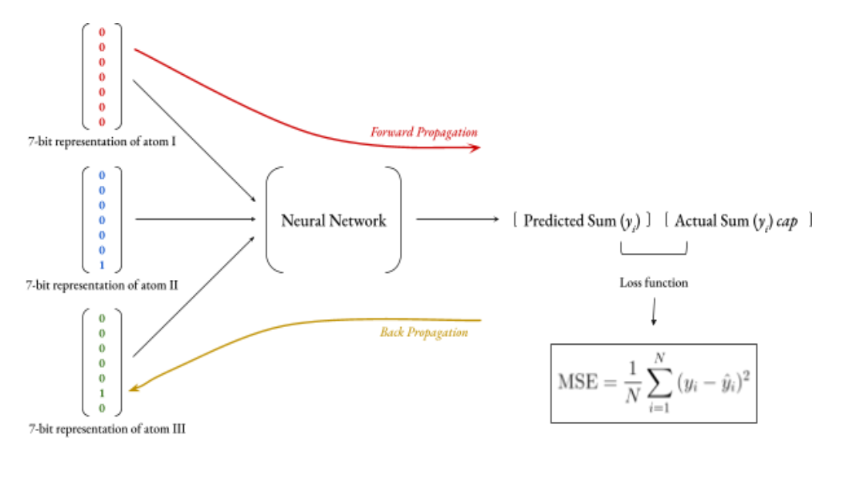

Slide 2
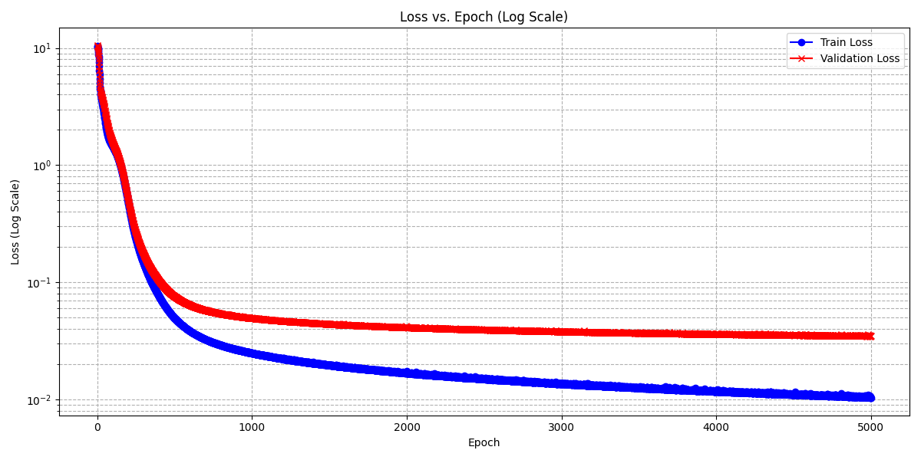
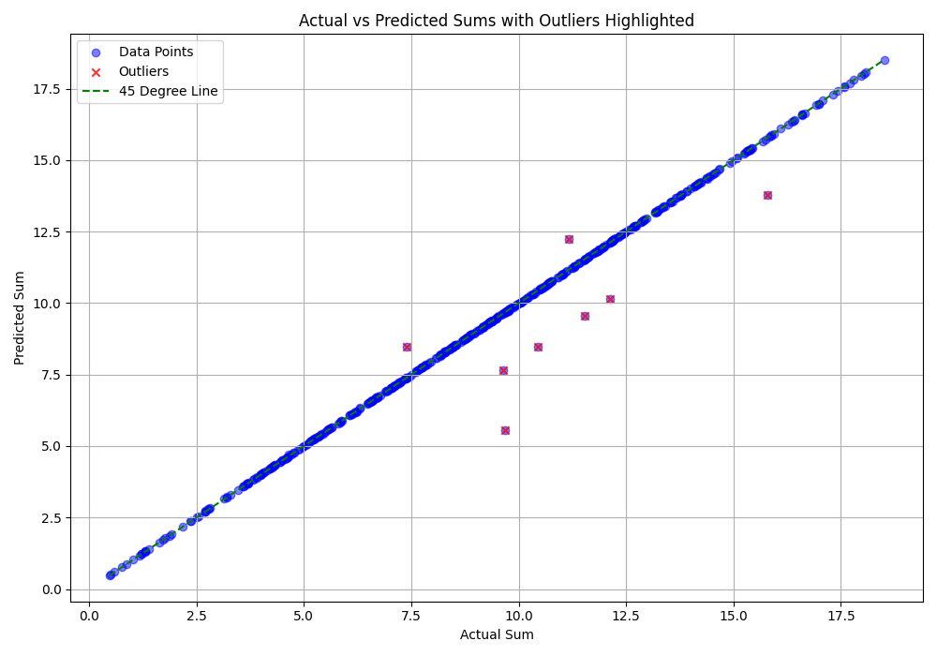
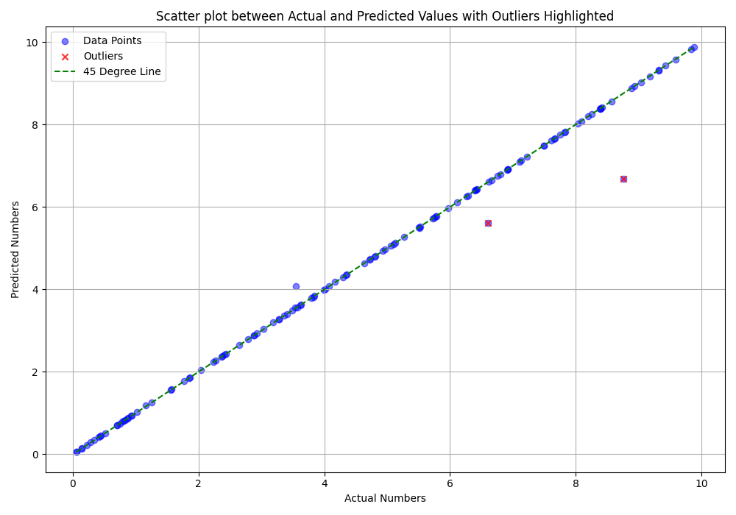
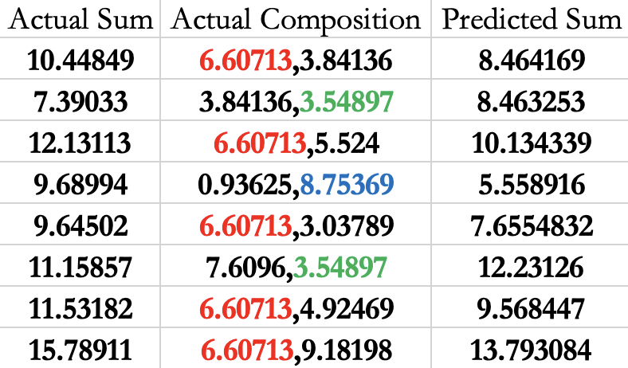
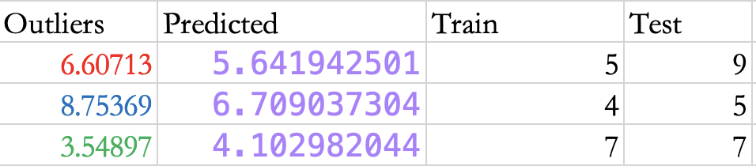

Slide 3
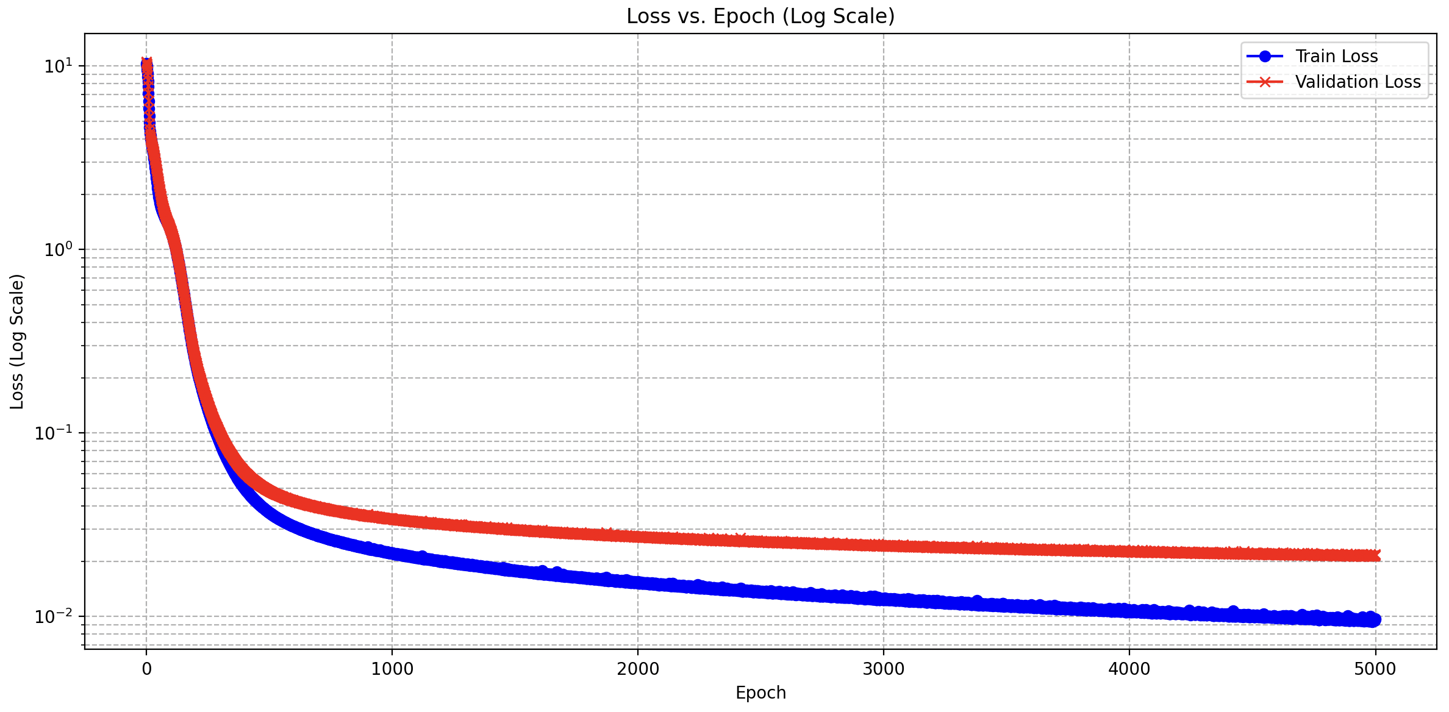
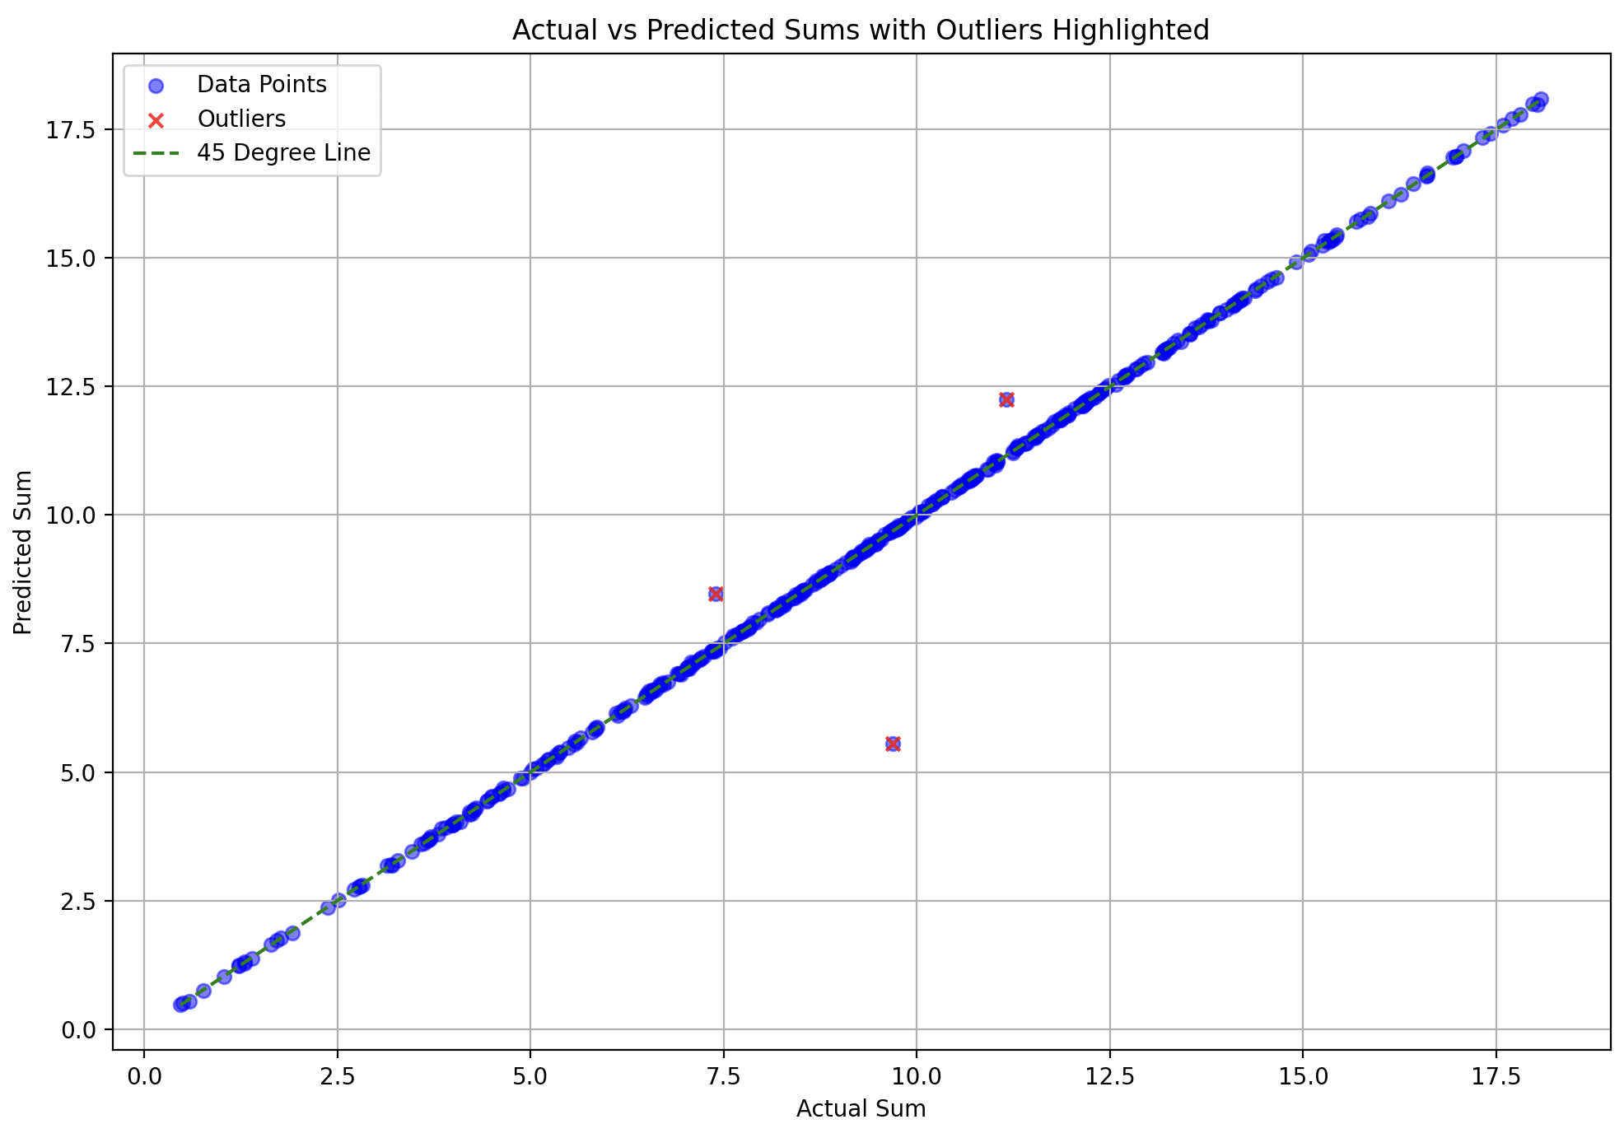
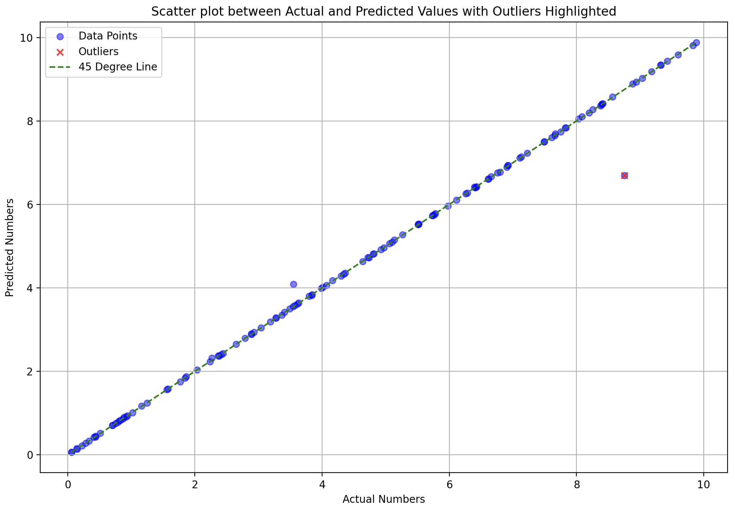
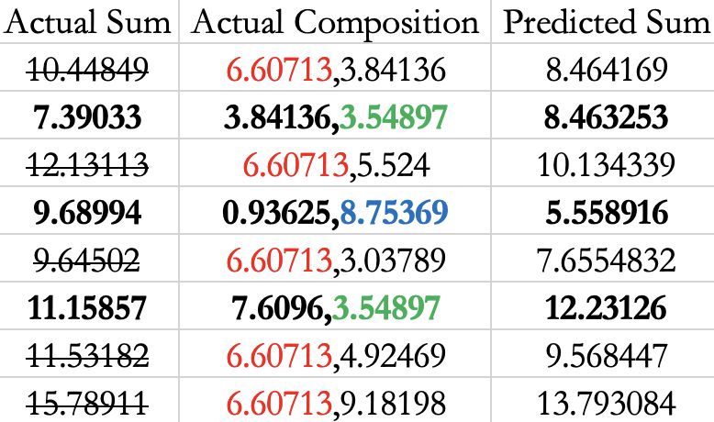
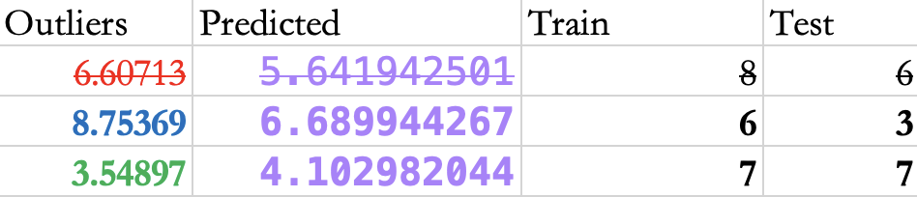

Slide 4
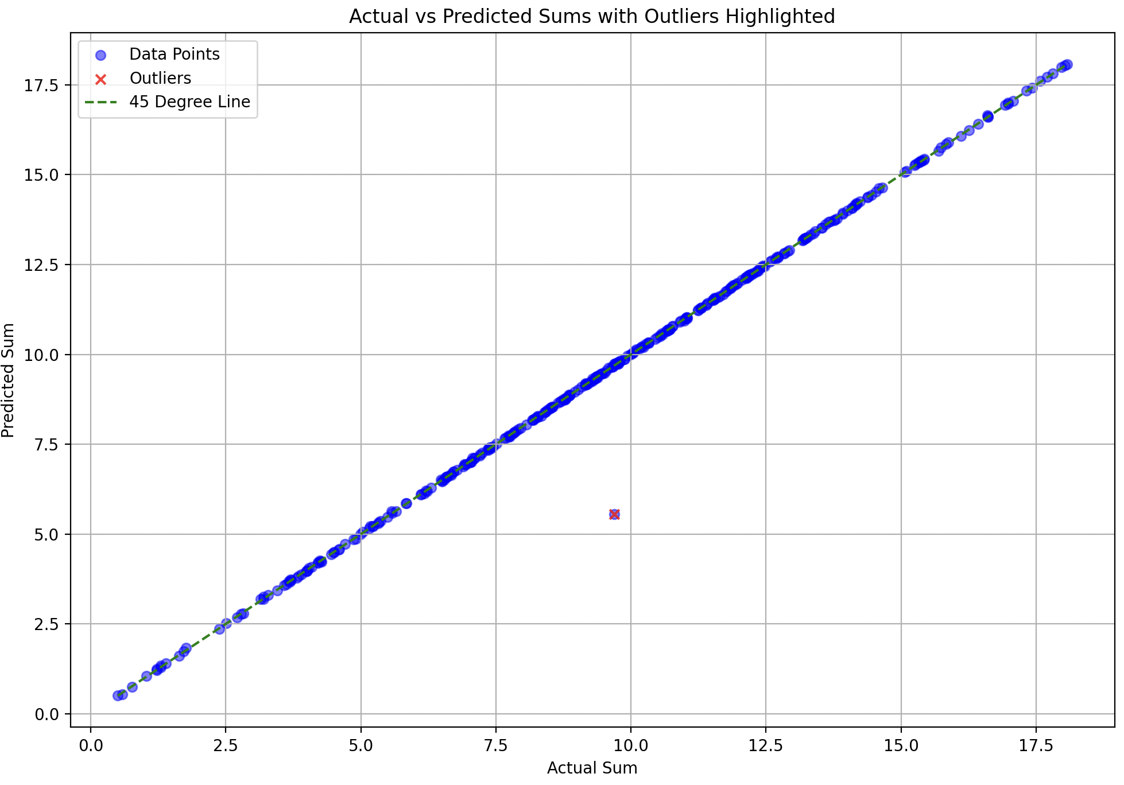
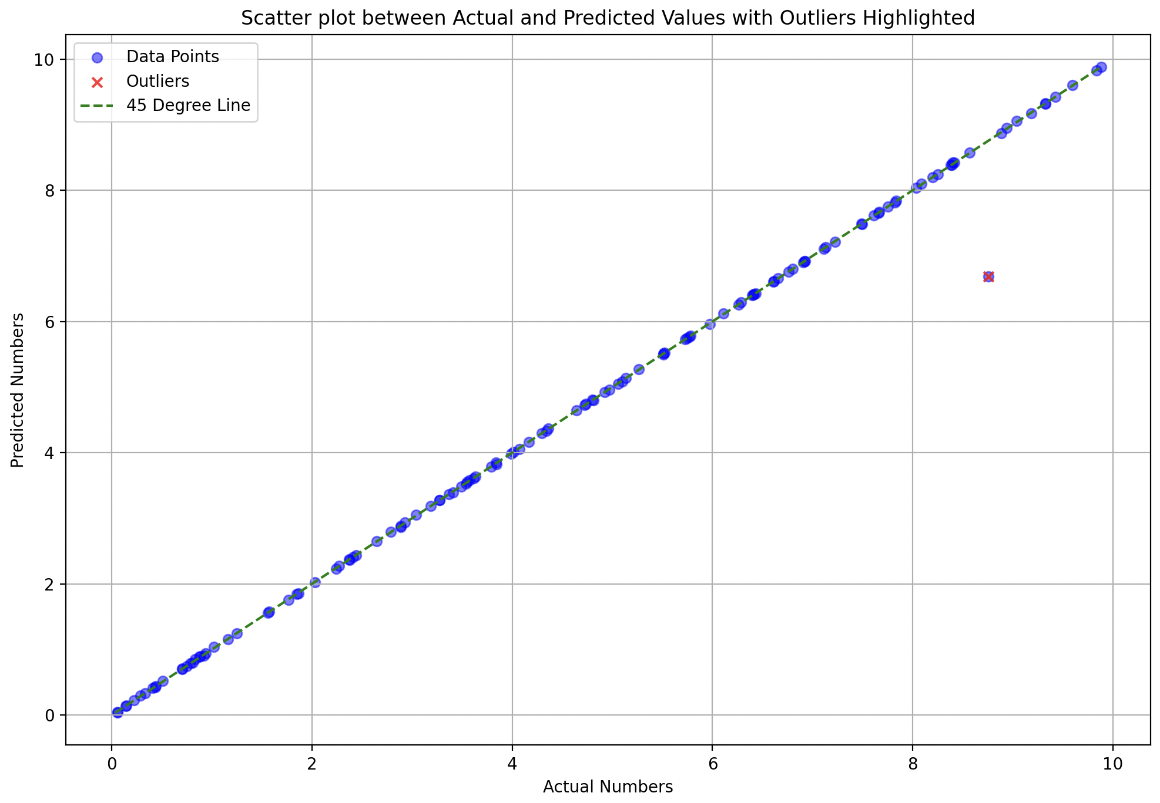
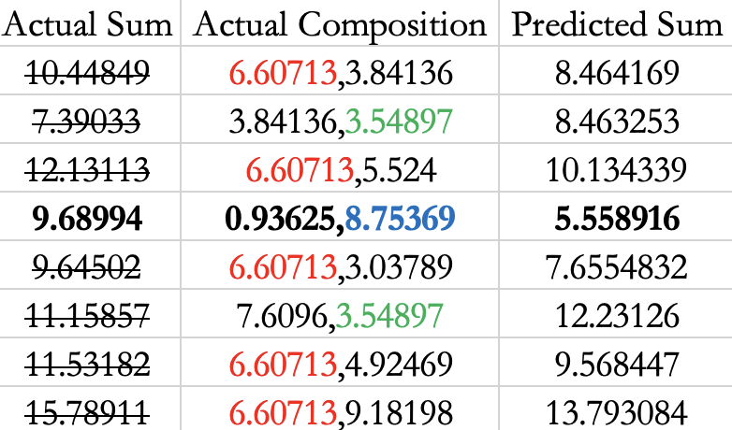
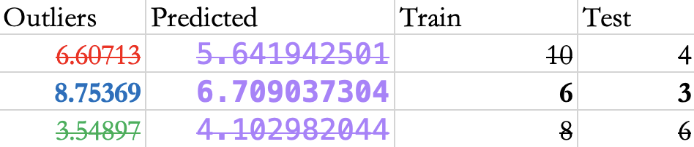

Slide 5
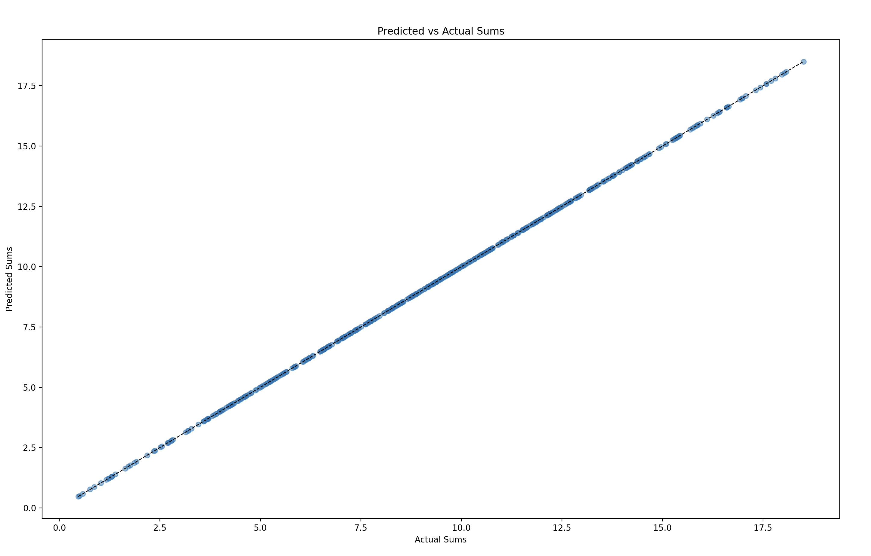
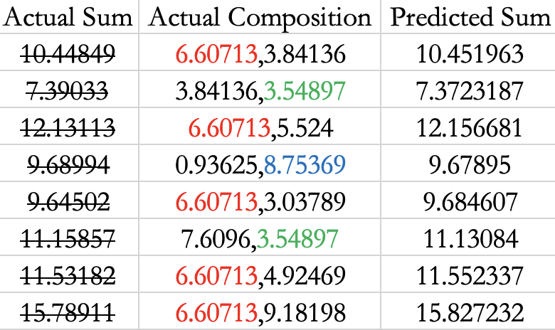
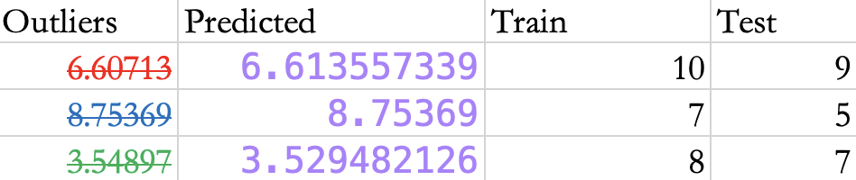
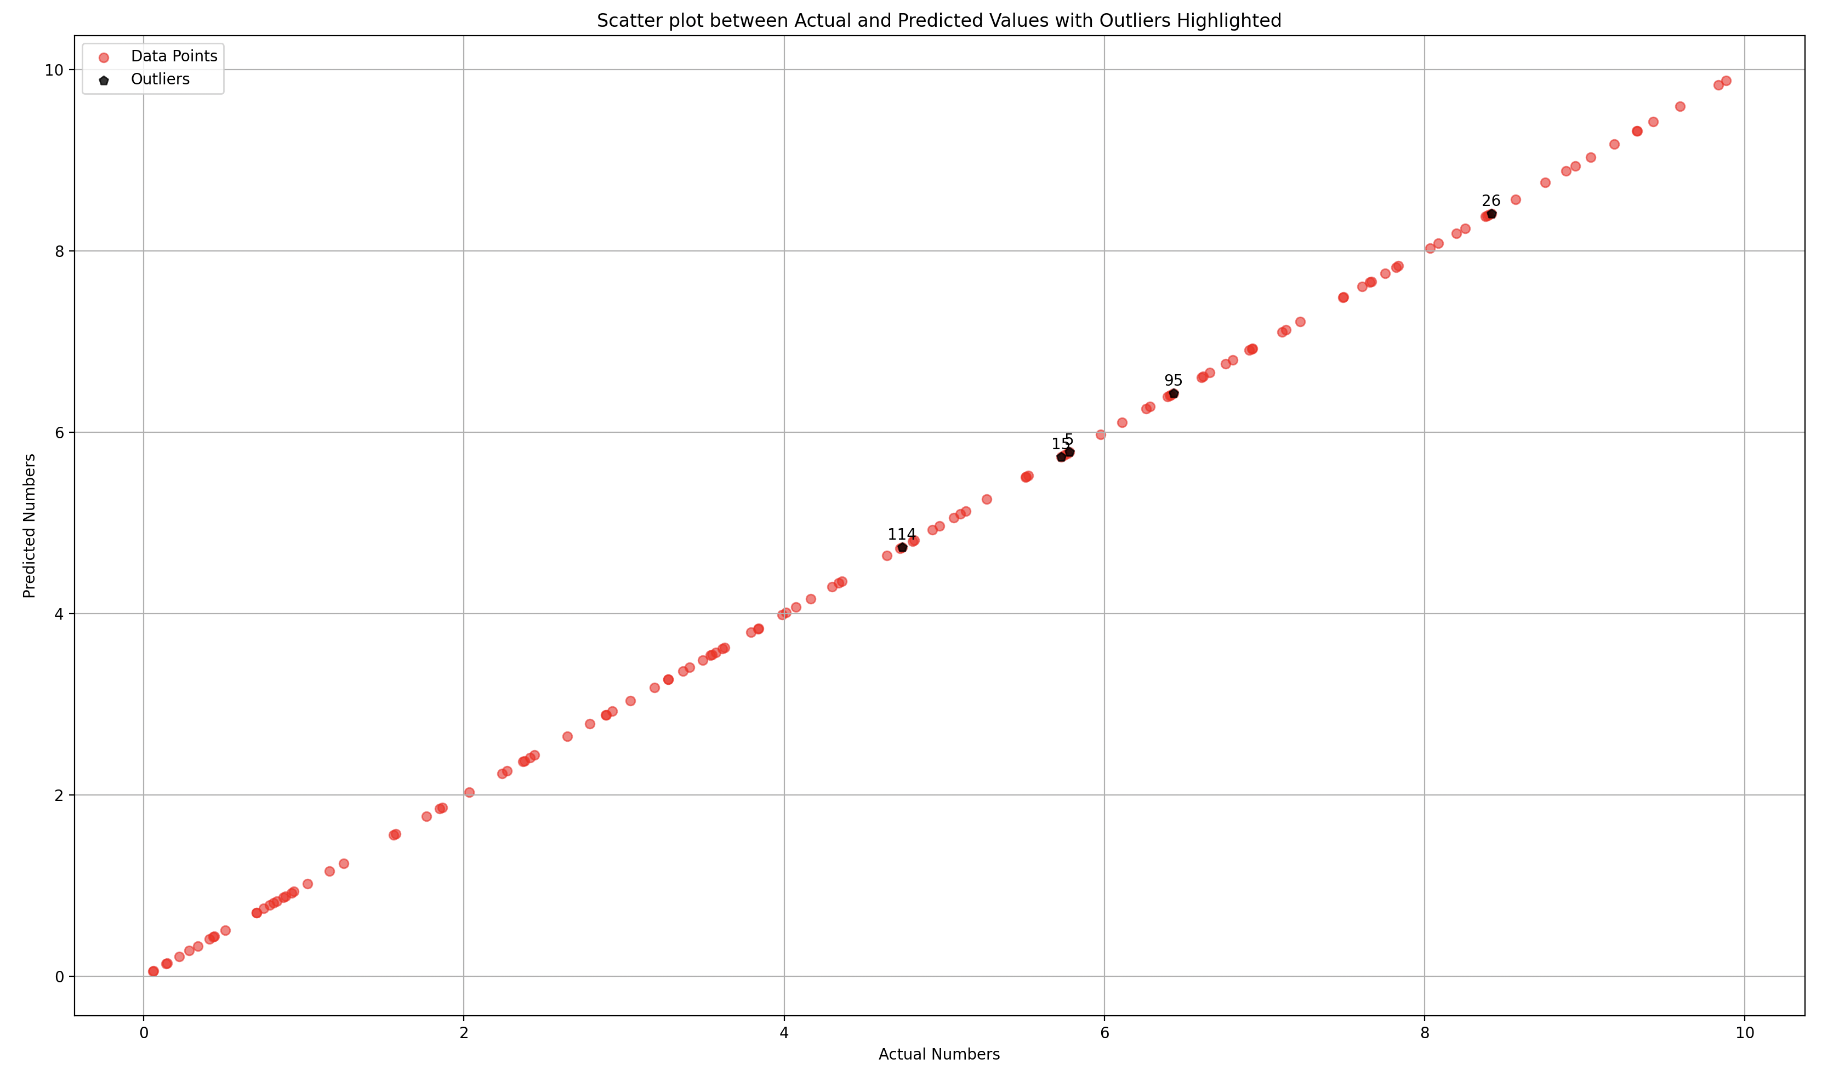
T
W
E
A
K
E
D
50-50

Slide 6
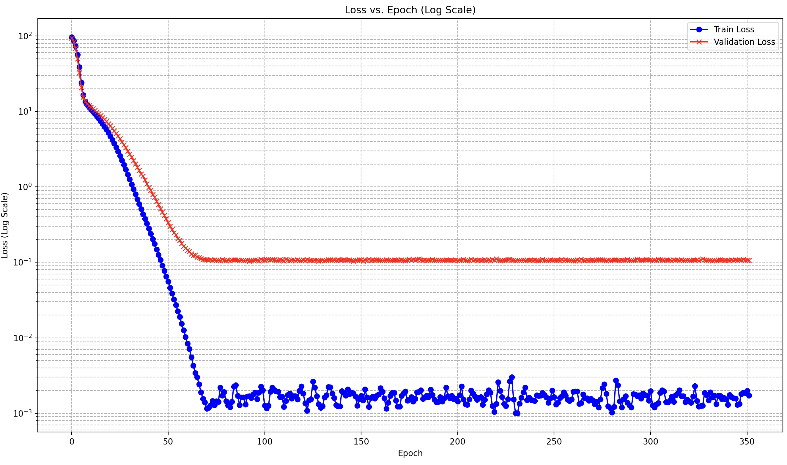
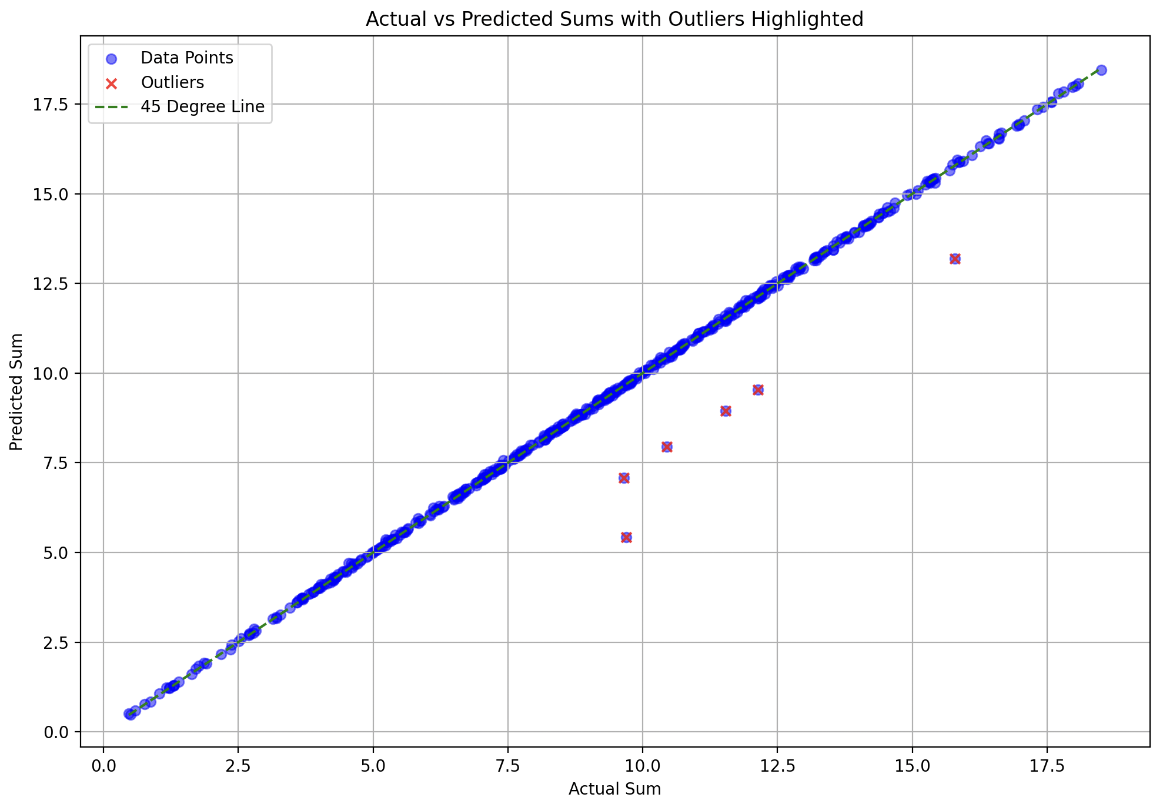
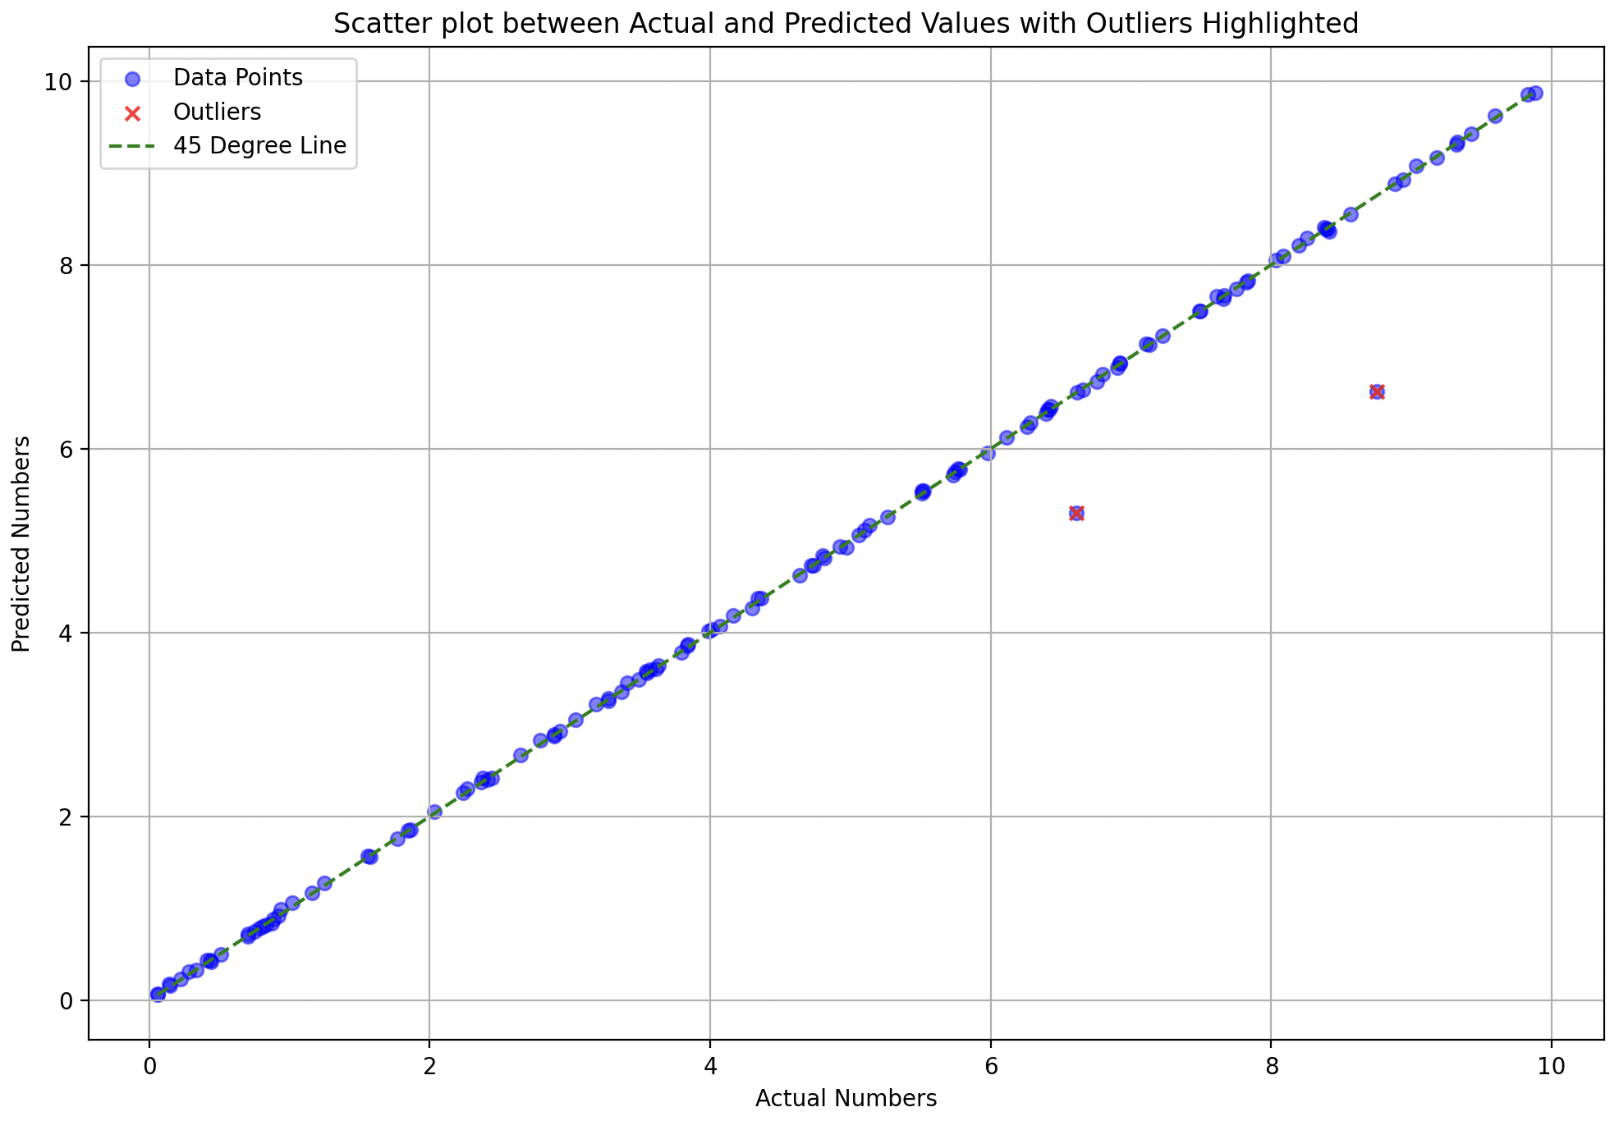
no decay, no dropout

Slide 7
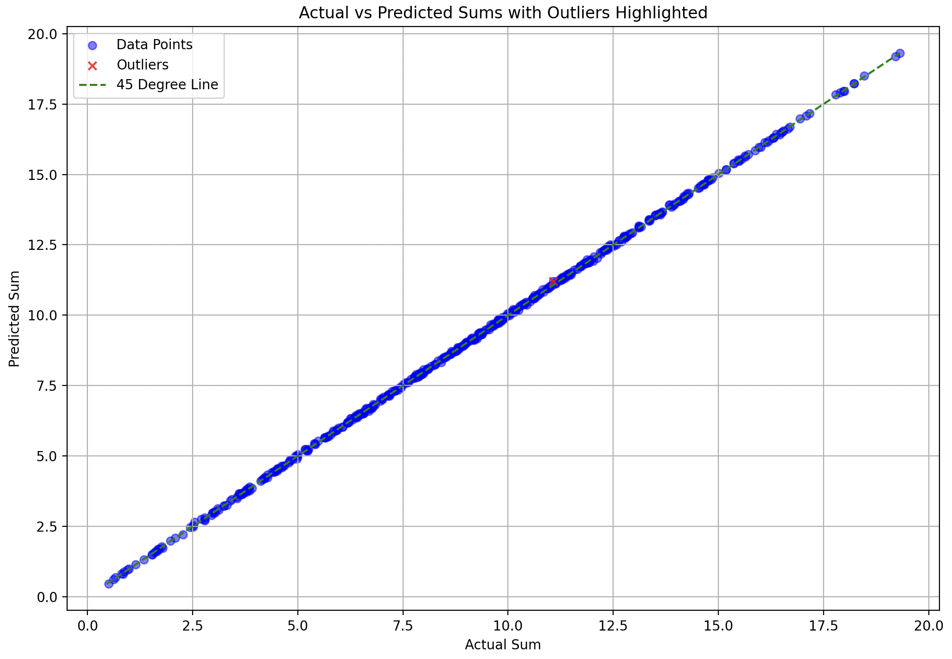
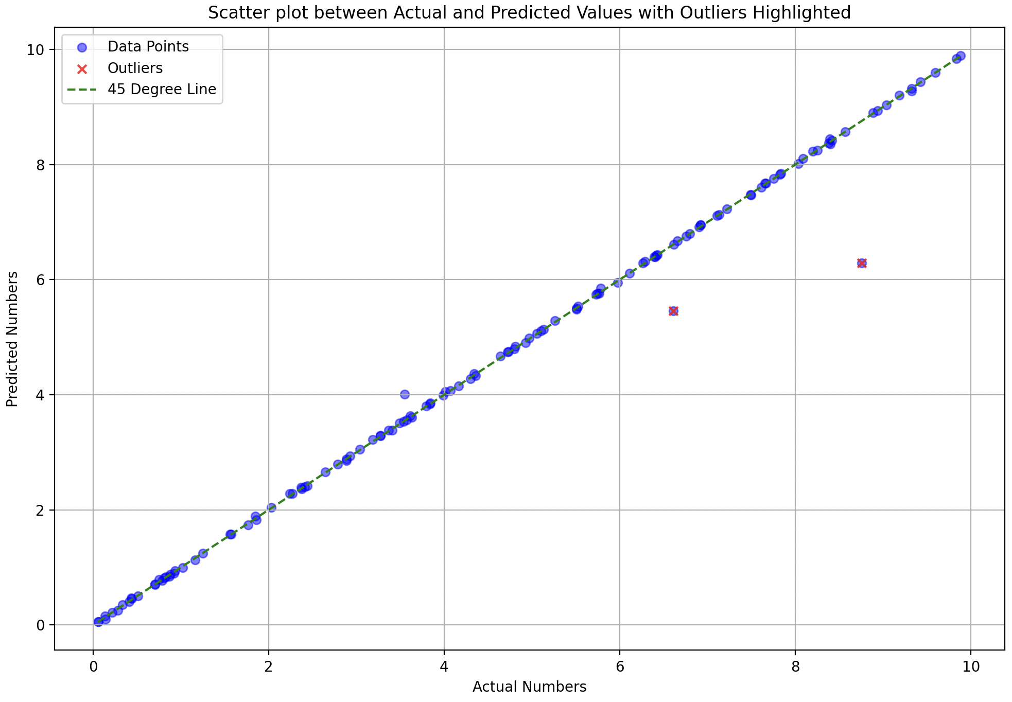
Performance on training data

Slide 8
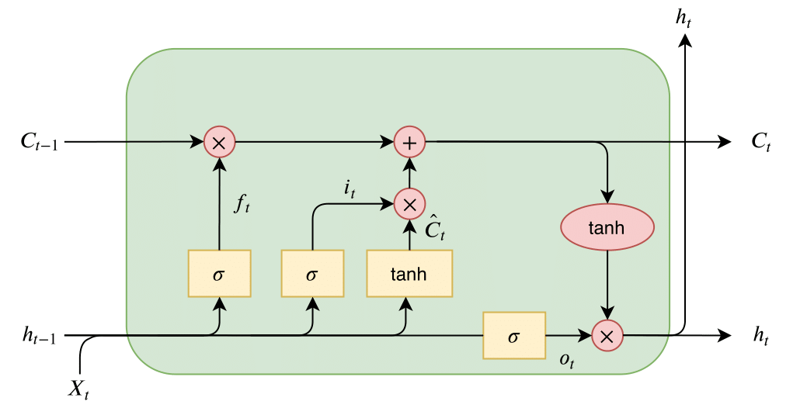

Slide 9
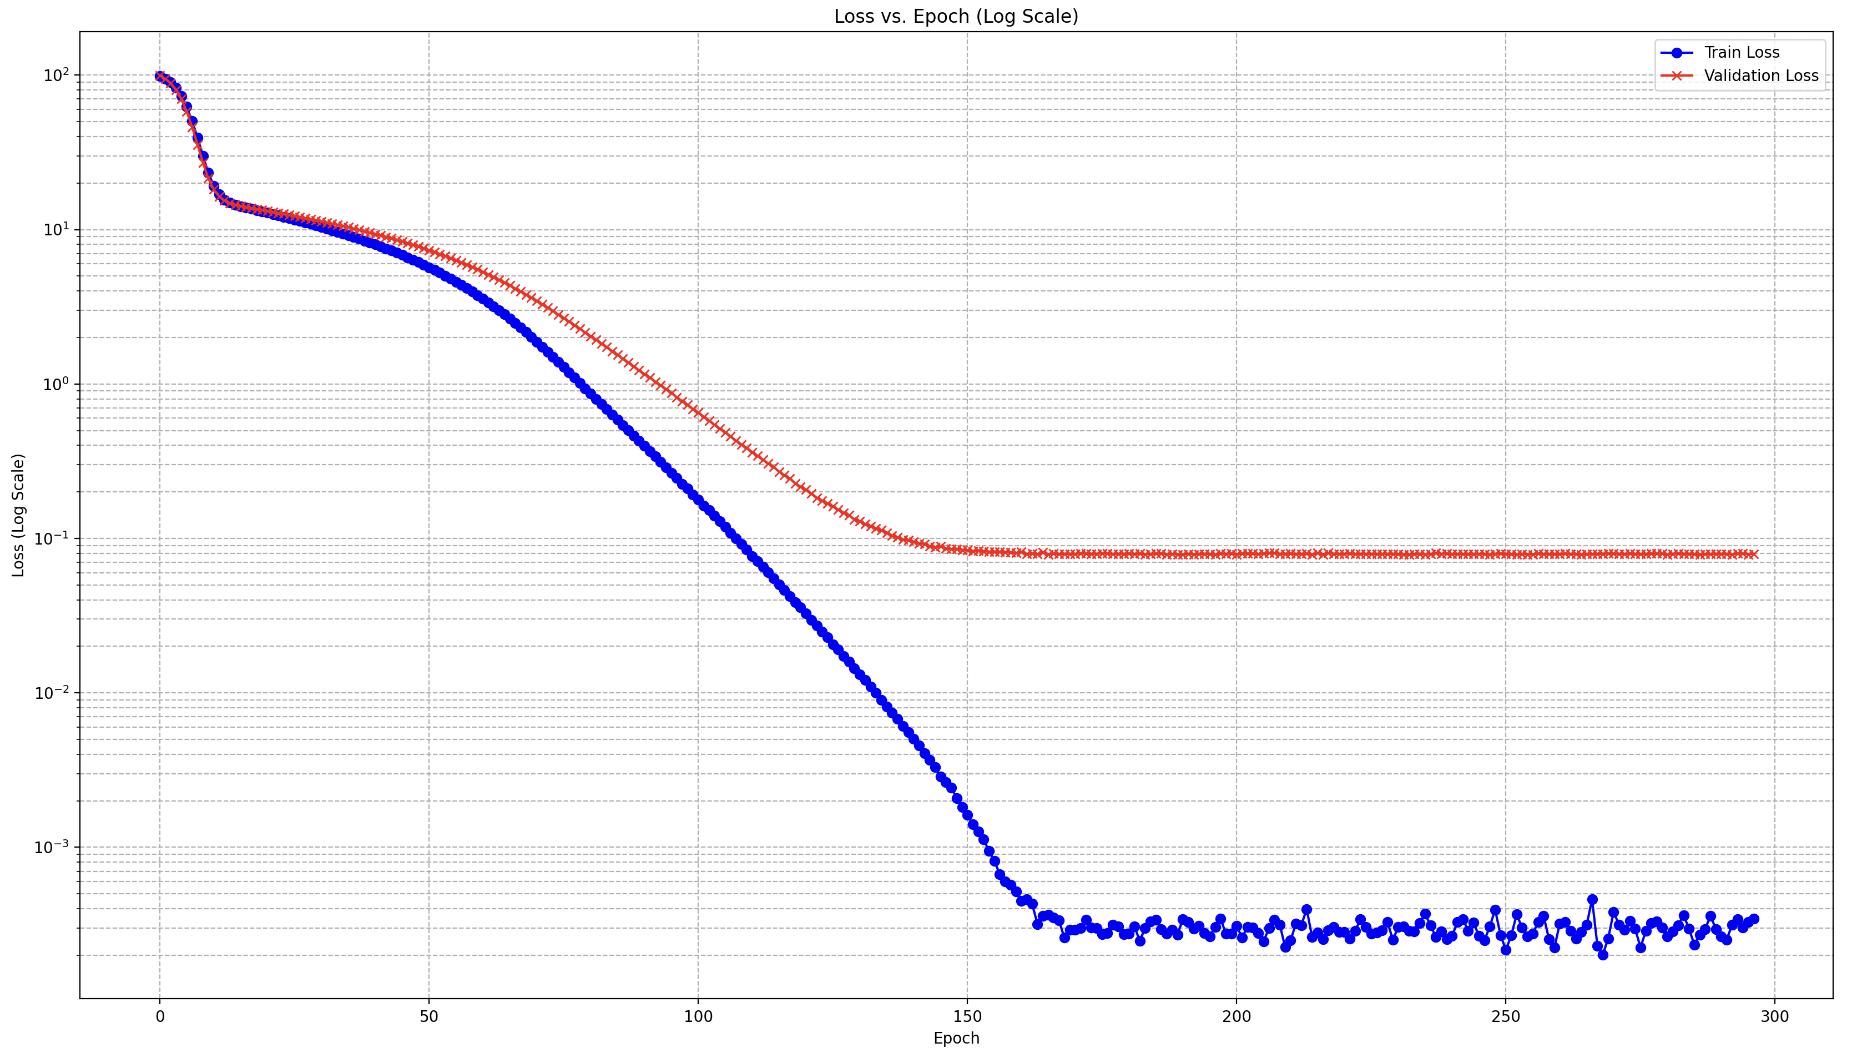
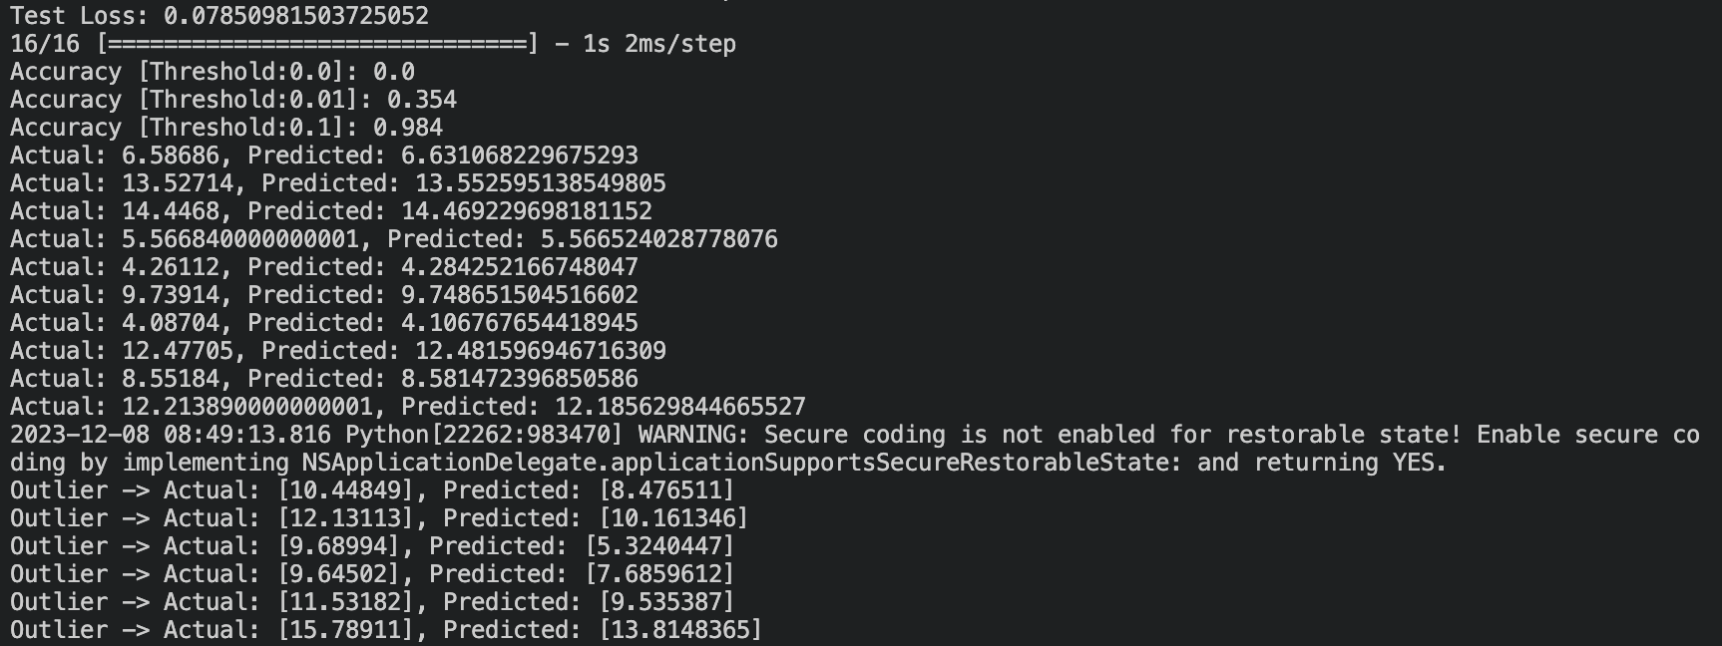
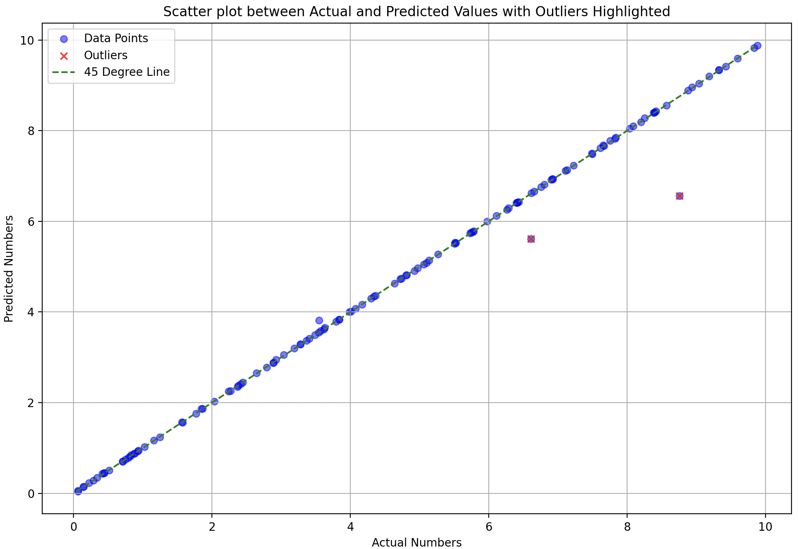
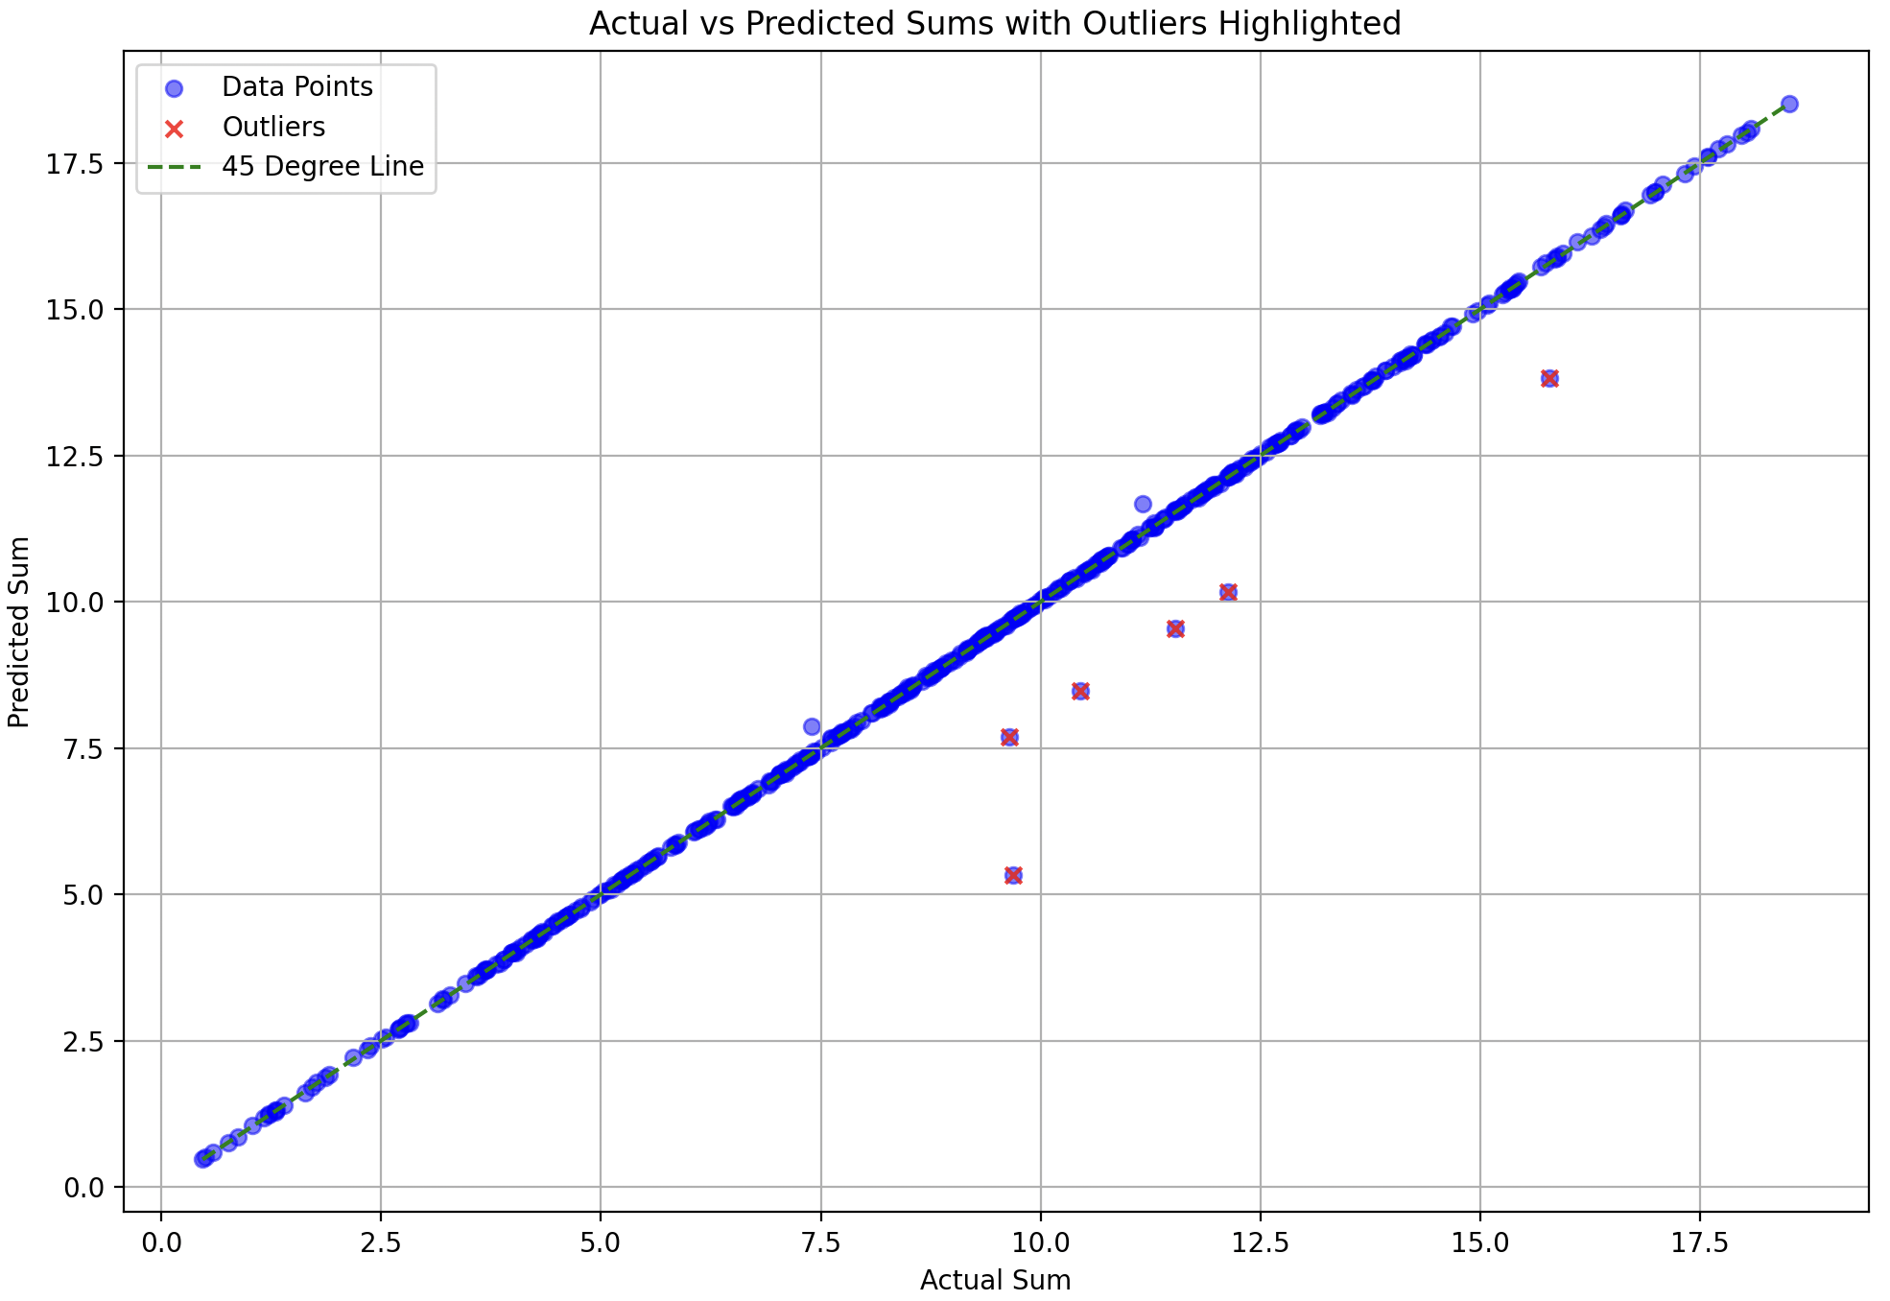
def shared_subnetwork(input_tensor): print(input_tensor.shape) x = LSTM(512, return_sequences=True)(input_tensor) ## h1 = LSTM(128, return_sequences=False)(x) h2 = Dense(64, activation='linear')(x) return h2
learning_rate = 0.00001
optimizer = Adam(learning_rate=learning_rate)
model.compile(optimizer=optimizer, loss='mean_squared_error’)
batch_size = 1
epochs = 800
Split: 50-50
You’re sending all numbers (128) for the left plot but what if not all 128 numbers come in training or some issue that is close to this)

Slide 10
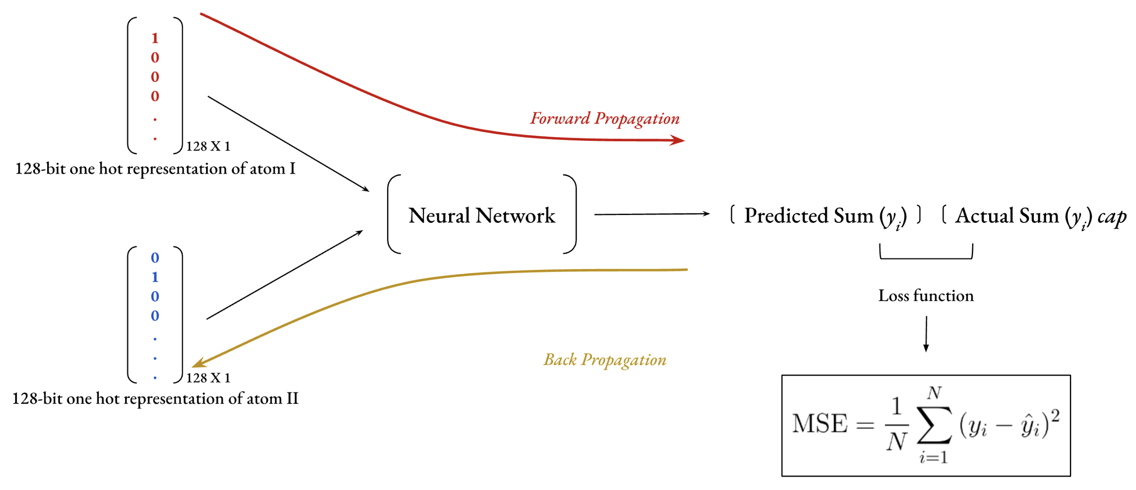

Slide 11
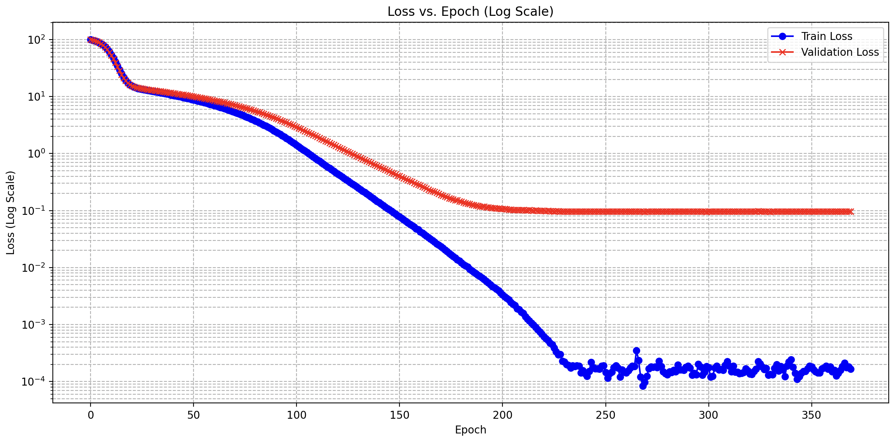
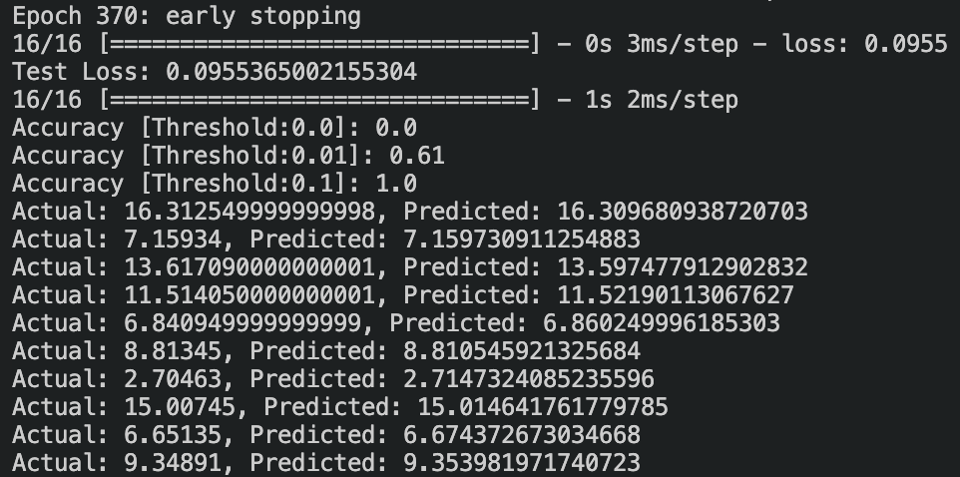
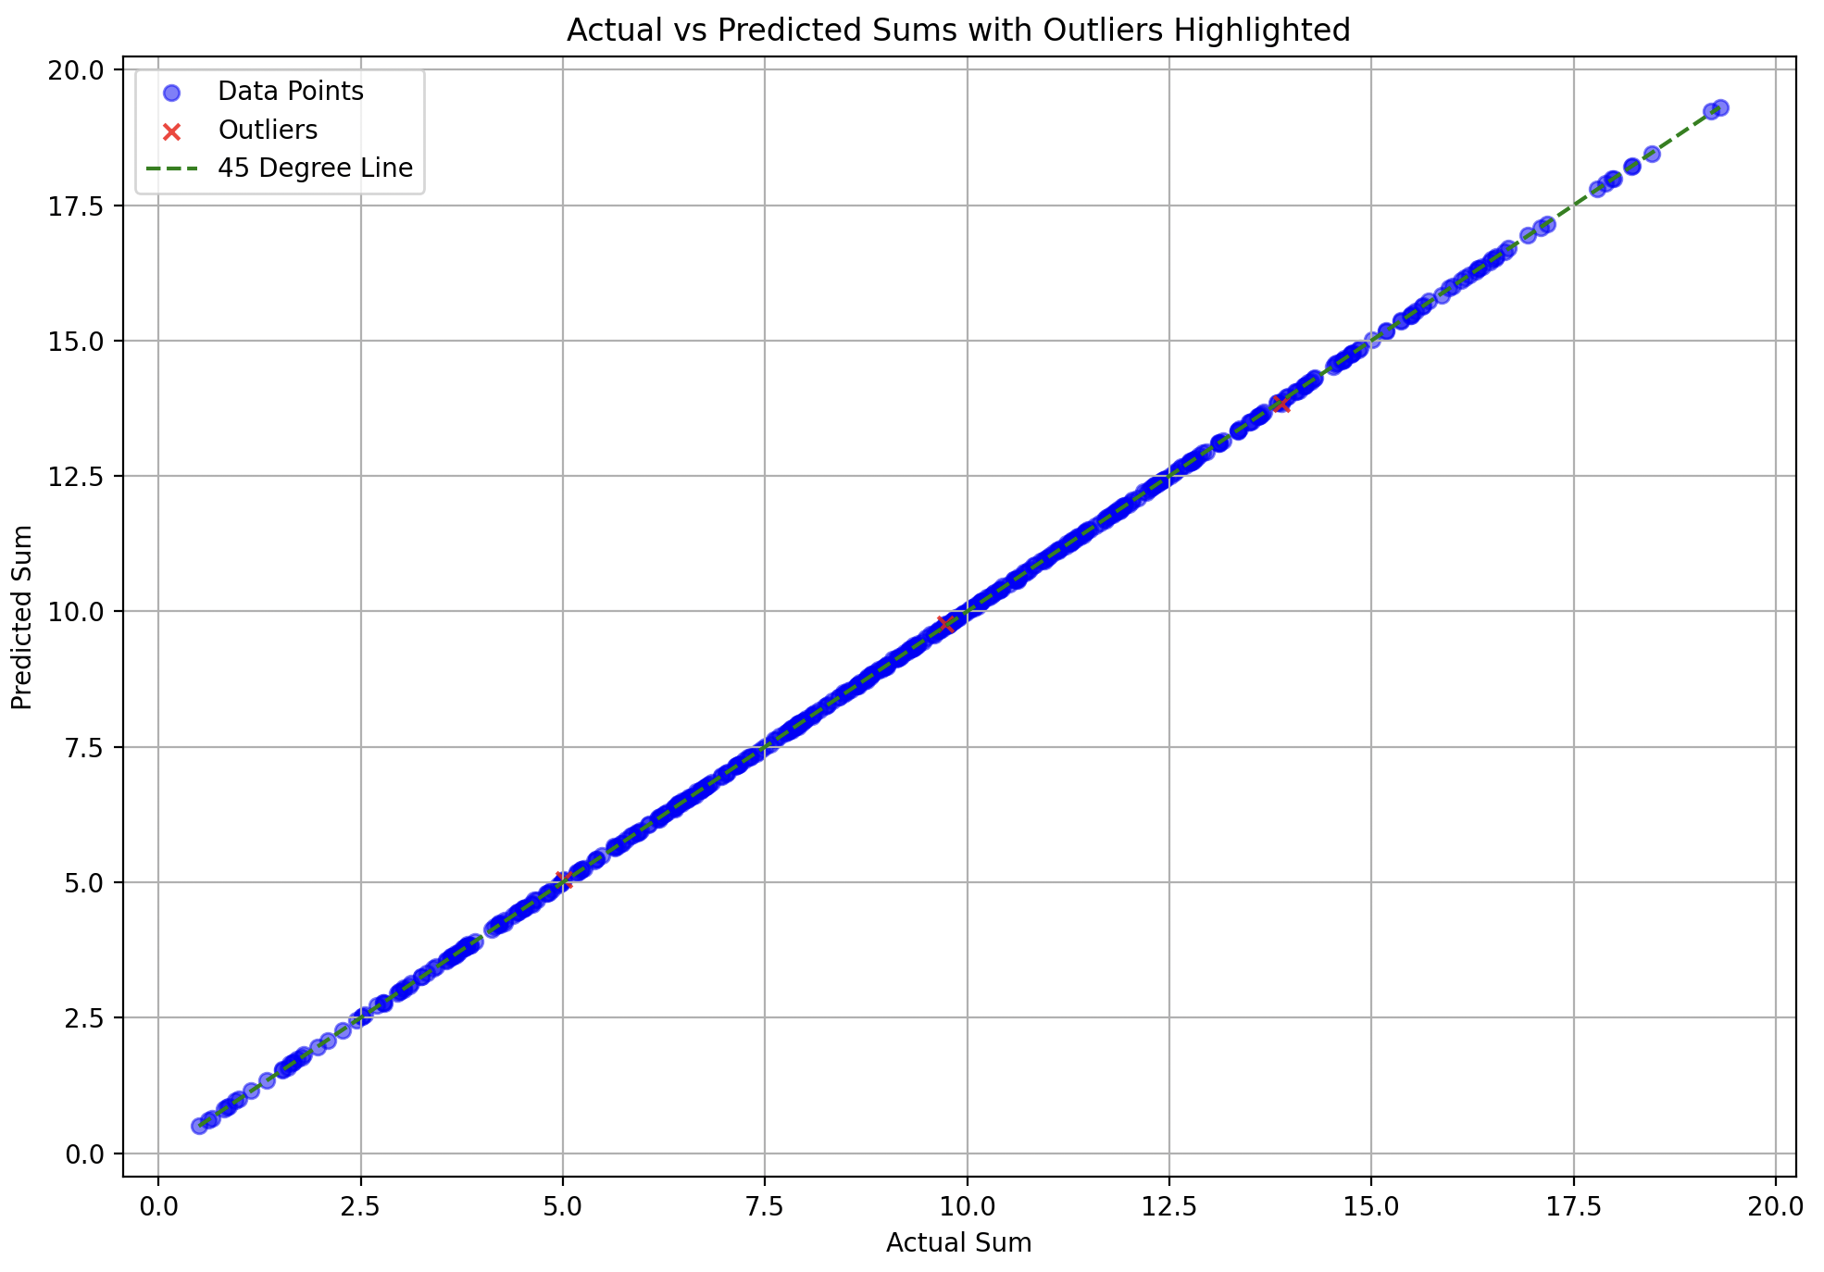
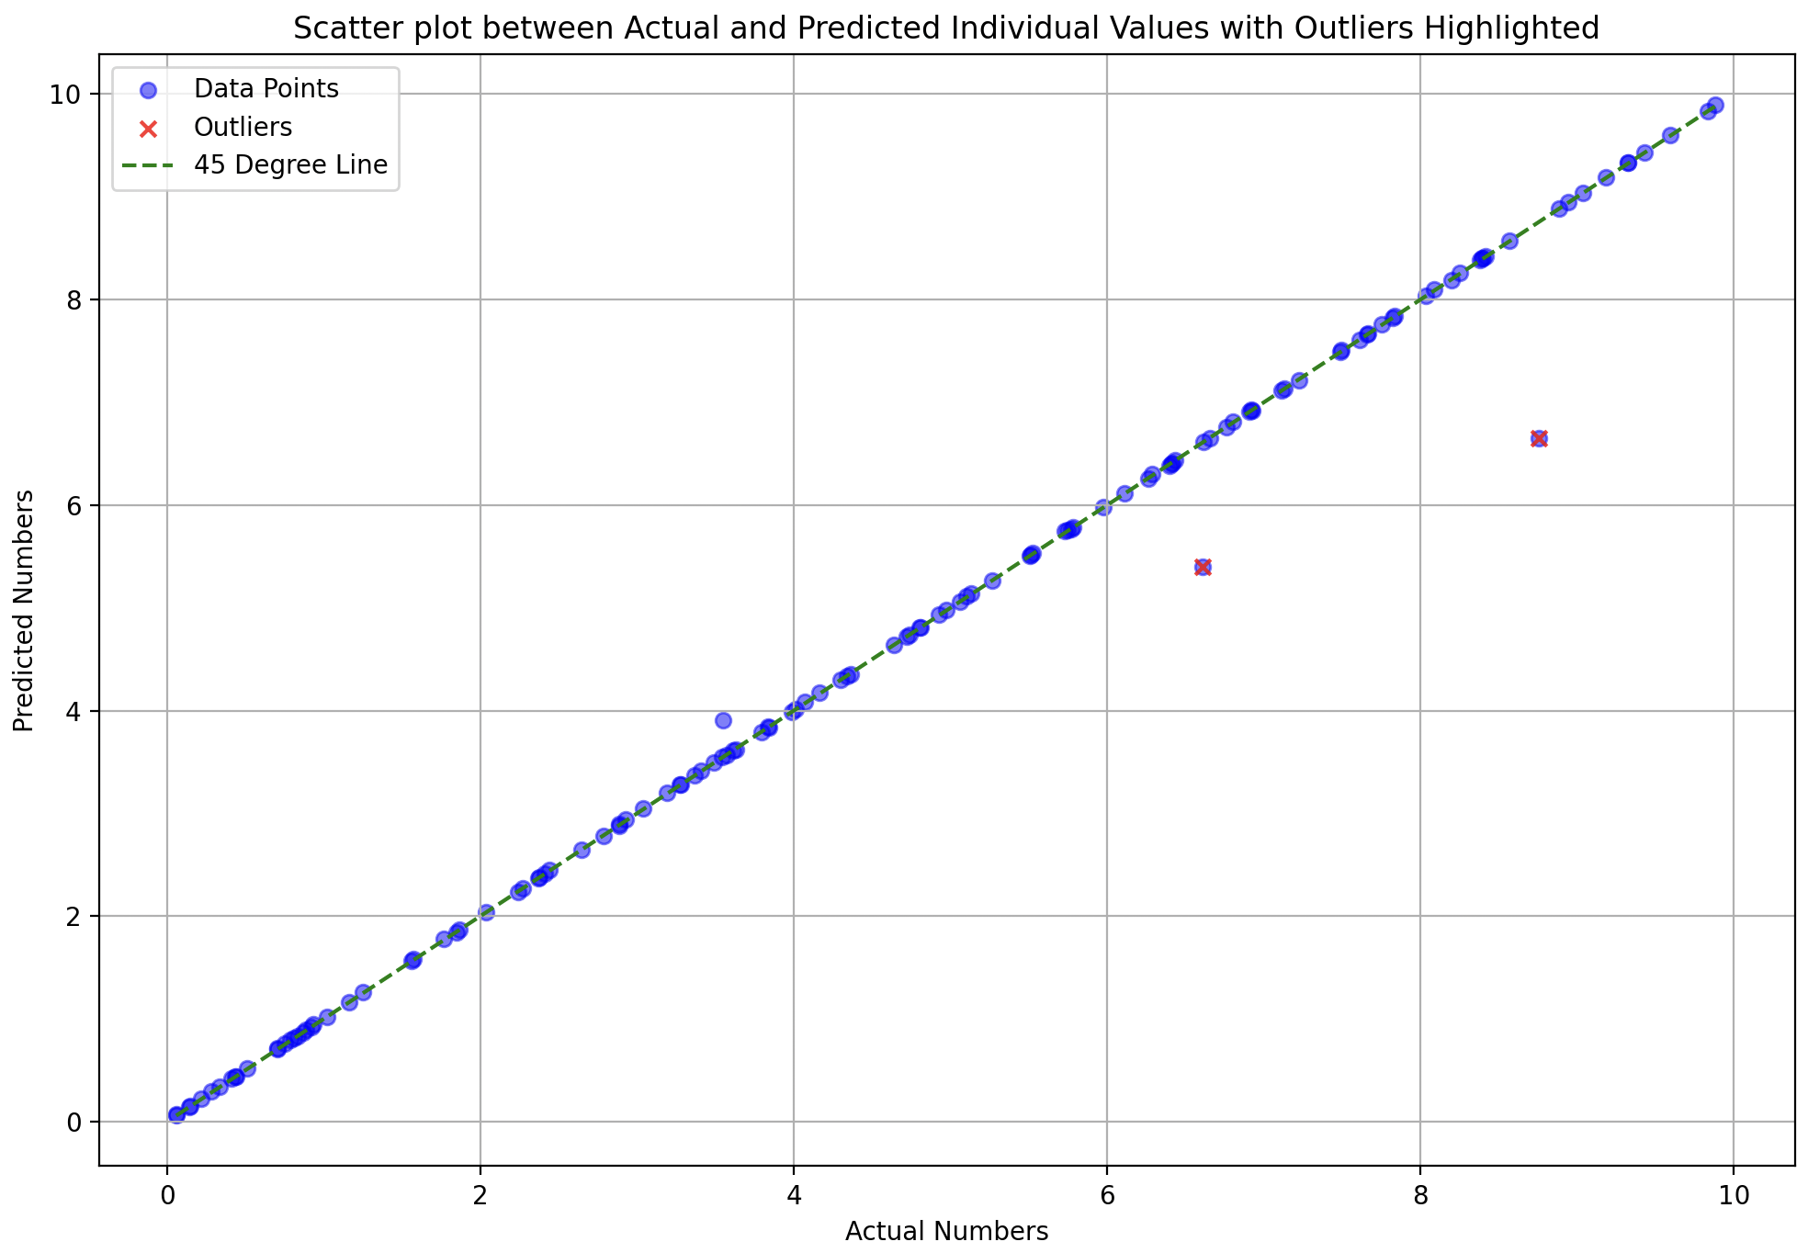
learning_rate = 0.00001 model.compile(optimizer=‘adam’, loss='mean_squared_error’) batch_size = 2 epochs = 800 early_stopping = EarlyStopping(monitor='val_loss', patience=100, verbose=1, restore_best_weights=True) ~no learning rate scheduler
Performance on training data

Slide 12
What’s wrong? Why the outliers?
Training is perfect
Not enough data for the model to learn (train on) all the pairs of numbers and their sums (present in testing but not in testing)
Model learns how to behave with training data, but not the new testing data (due to less data?)

Slide 13
Try [0-20] spread – does variety help? (-)
Contextual based - environment of the number in the pair matters? (+)

Slide 14
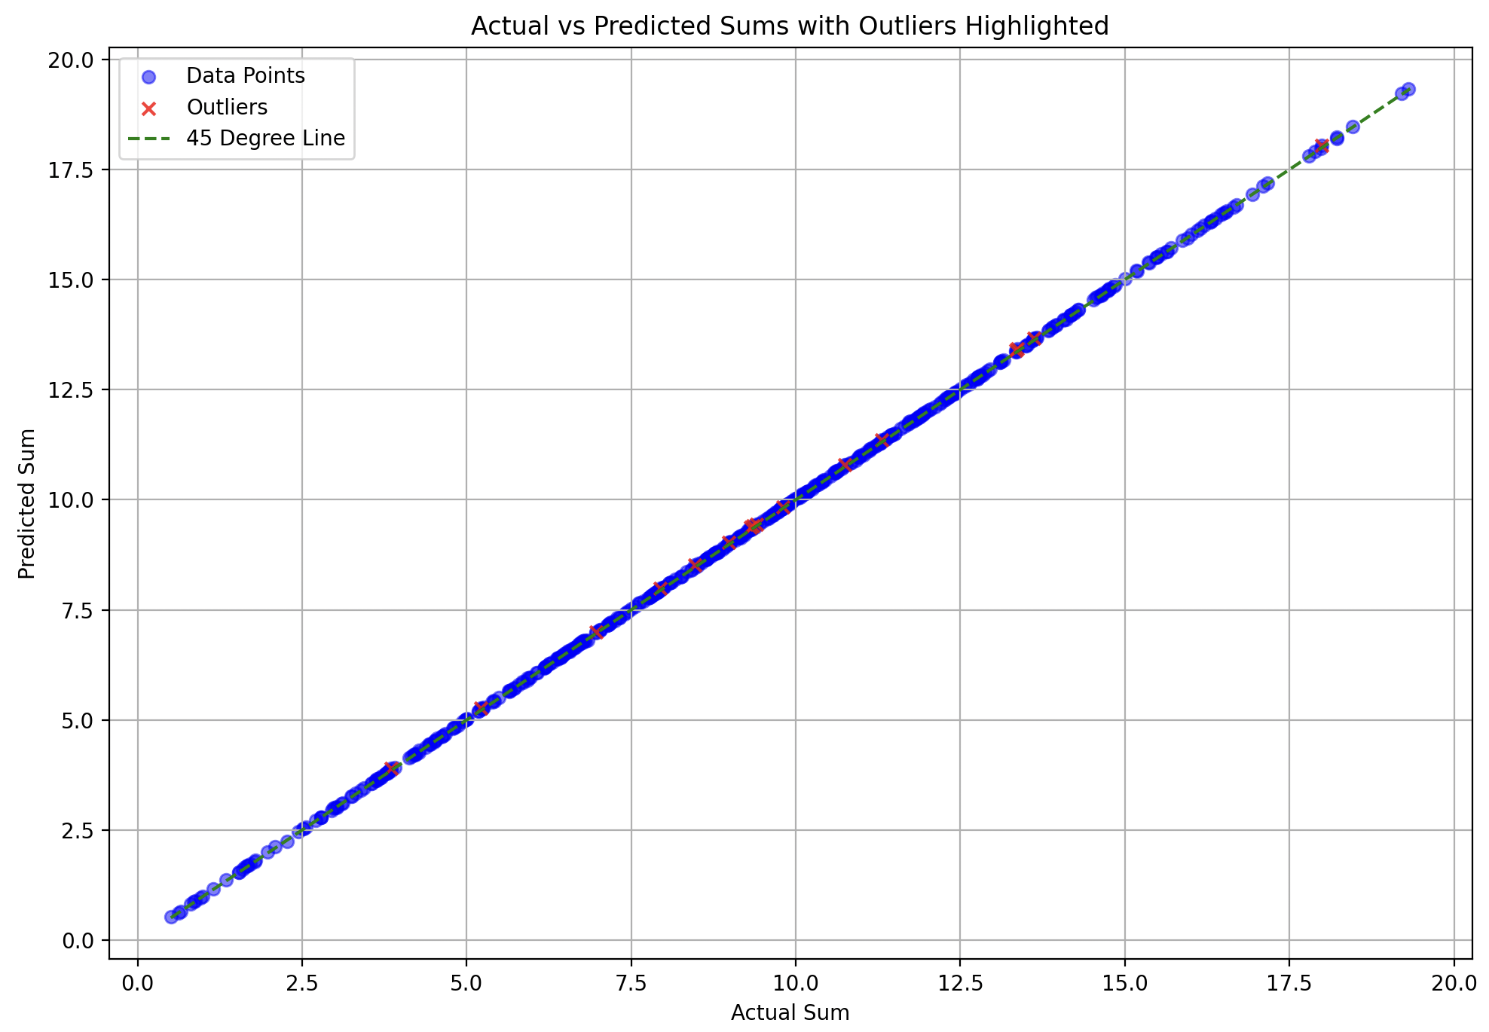
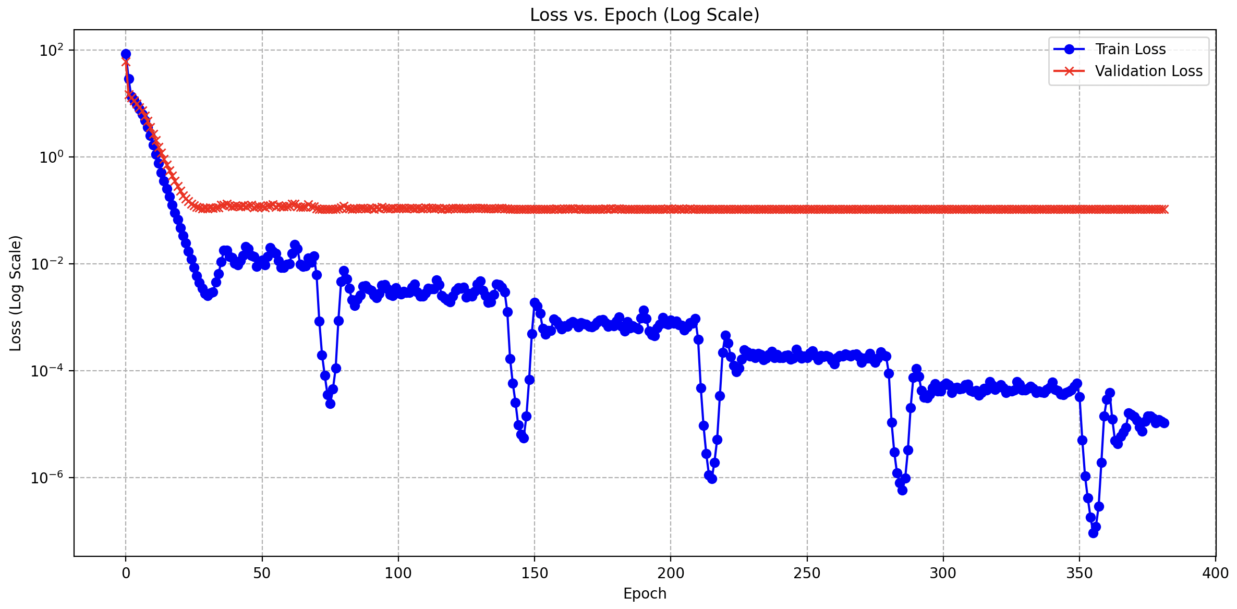
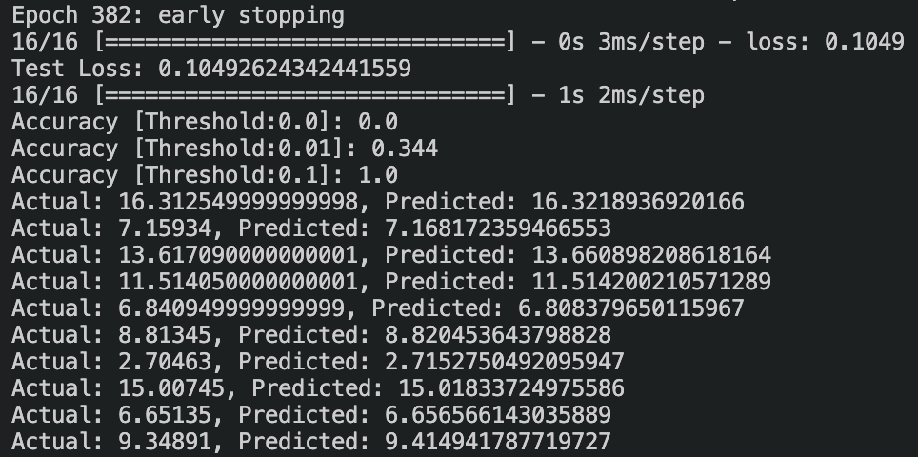
model.compile(optimizer=‘Adam’, loss='mean_squared_error’) batch_size = 2 epochs = 490 early_stopping = EarlyStopping(monitor='val_loss', patience=150, verbose=1, restore_best_weights=True) ~ learning rate scheduler initial_lr = 0.0001 decay_factor = 0.5 step_size = 70

Slide 15
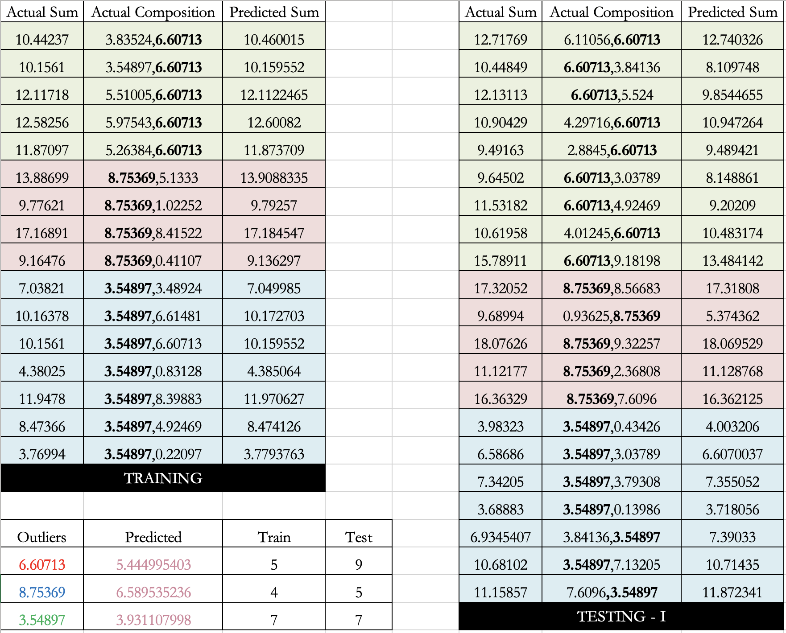
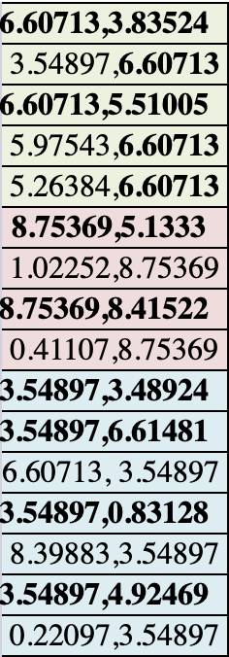

Slide 16
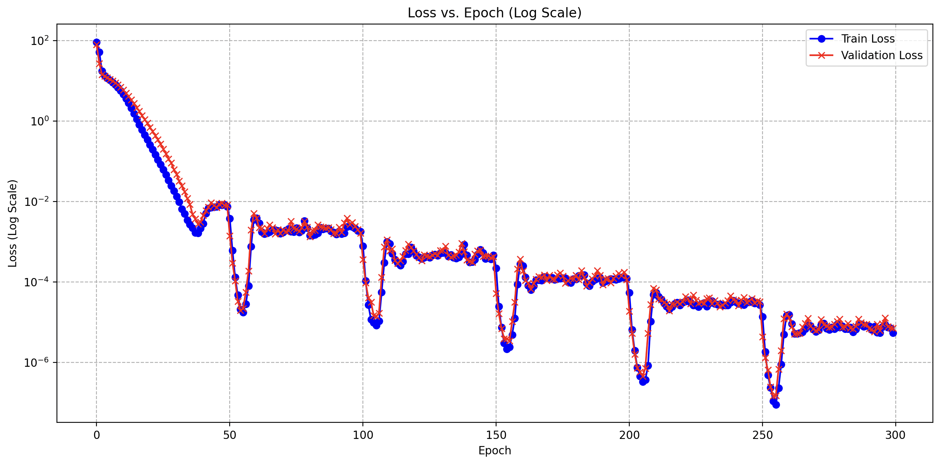
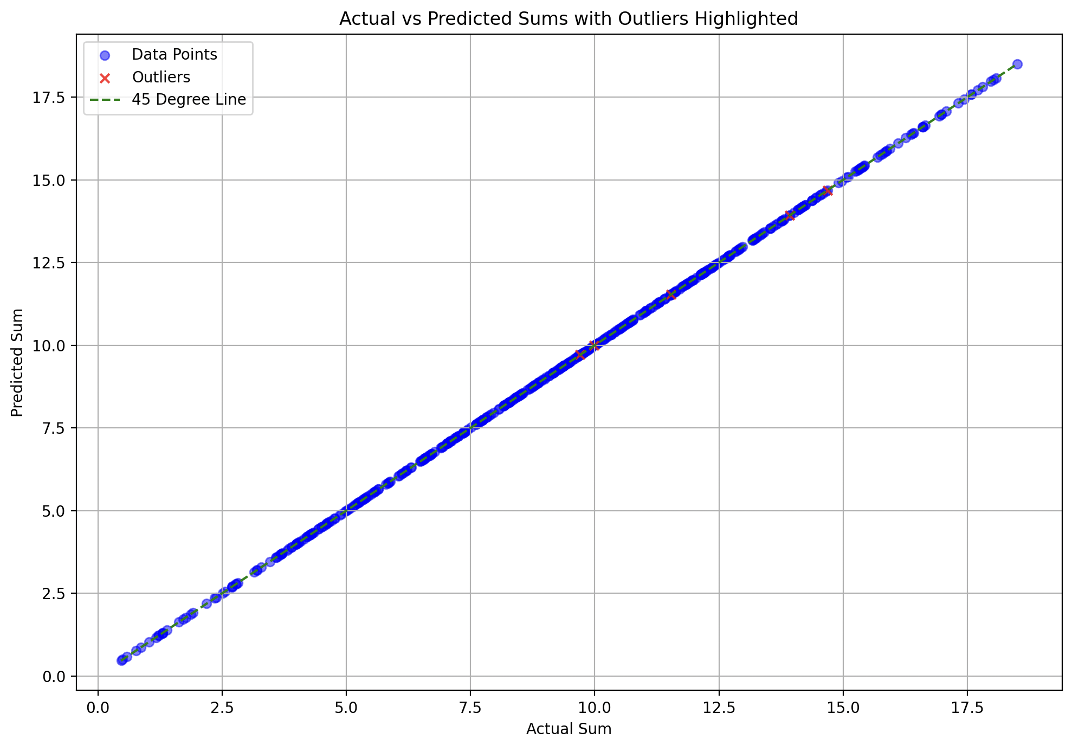
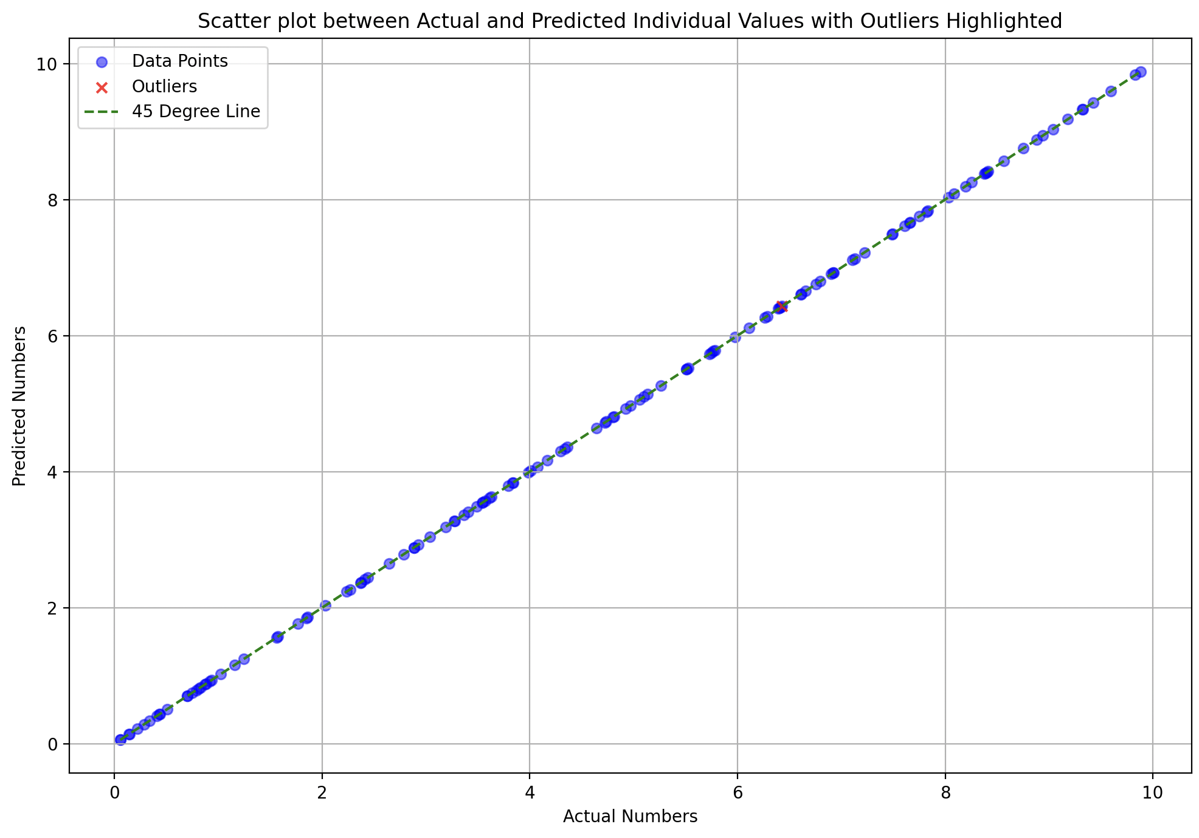
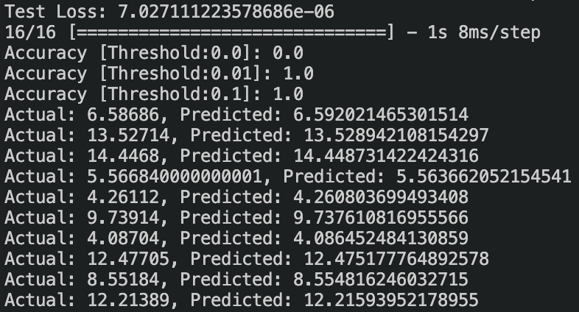

Slide 17
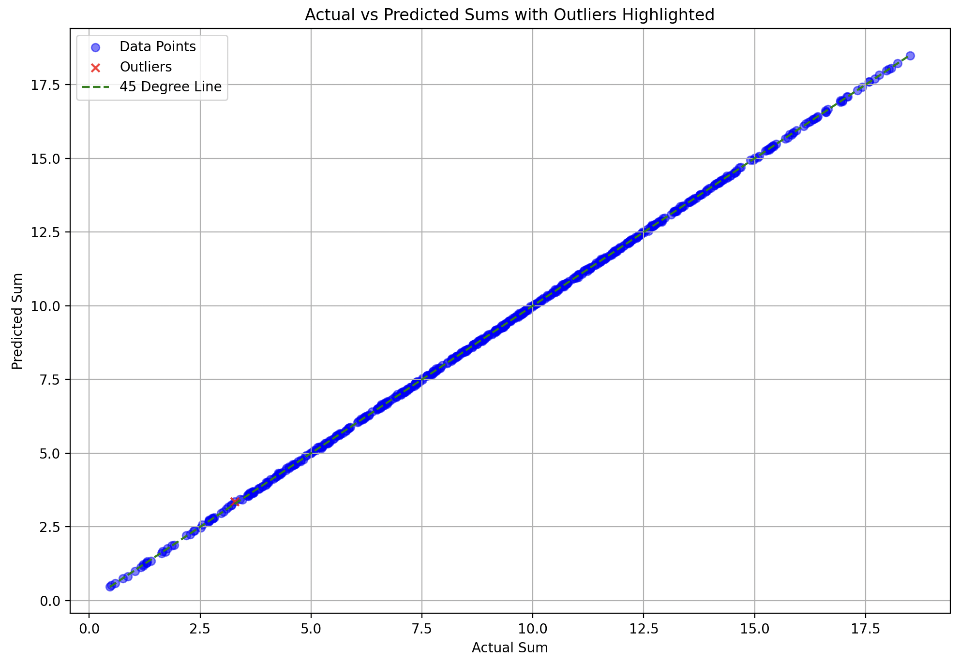
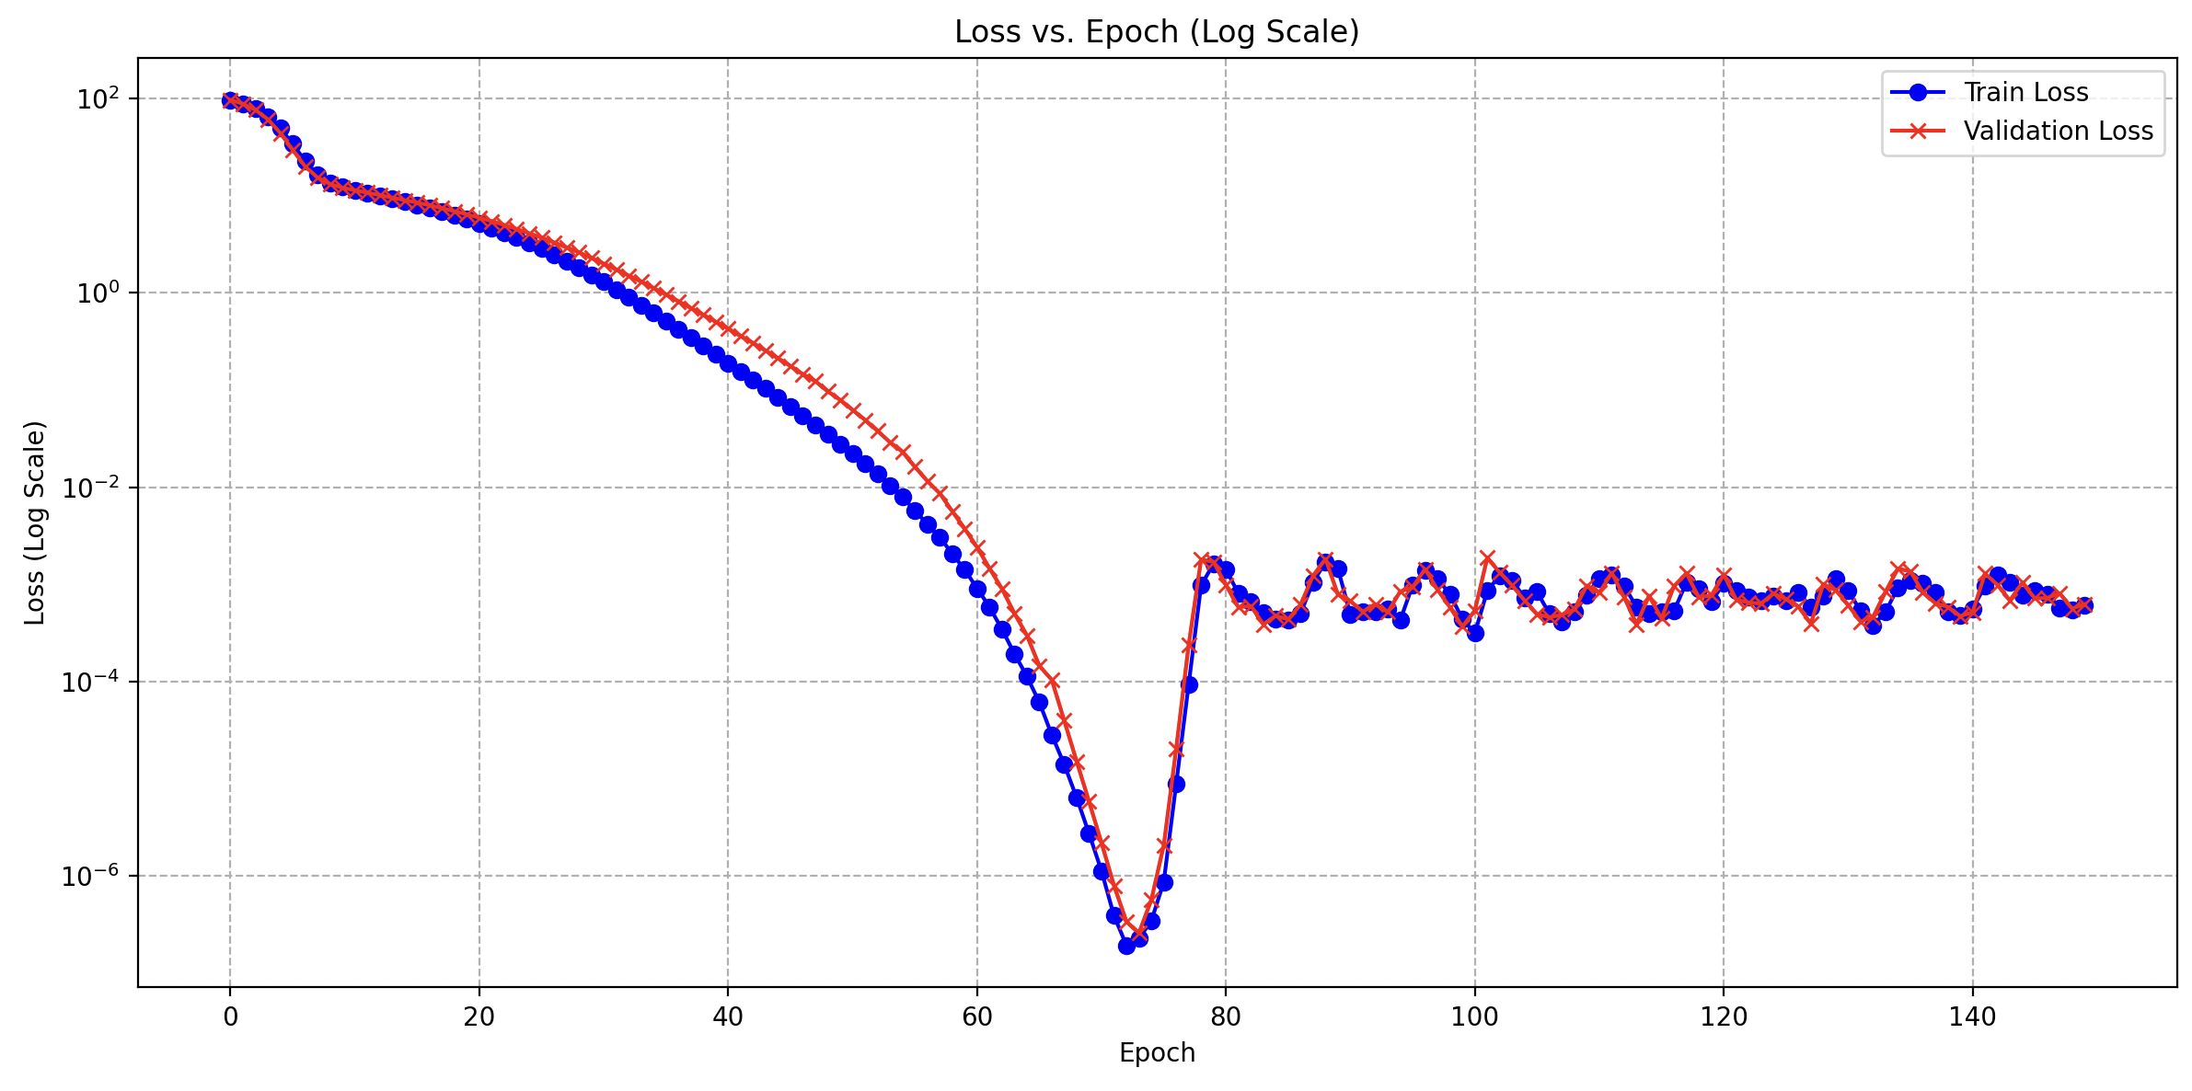
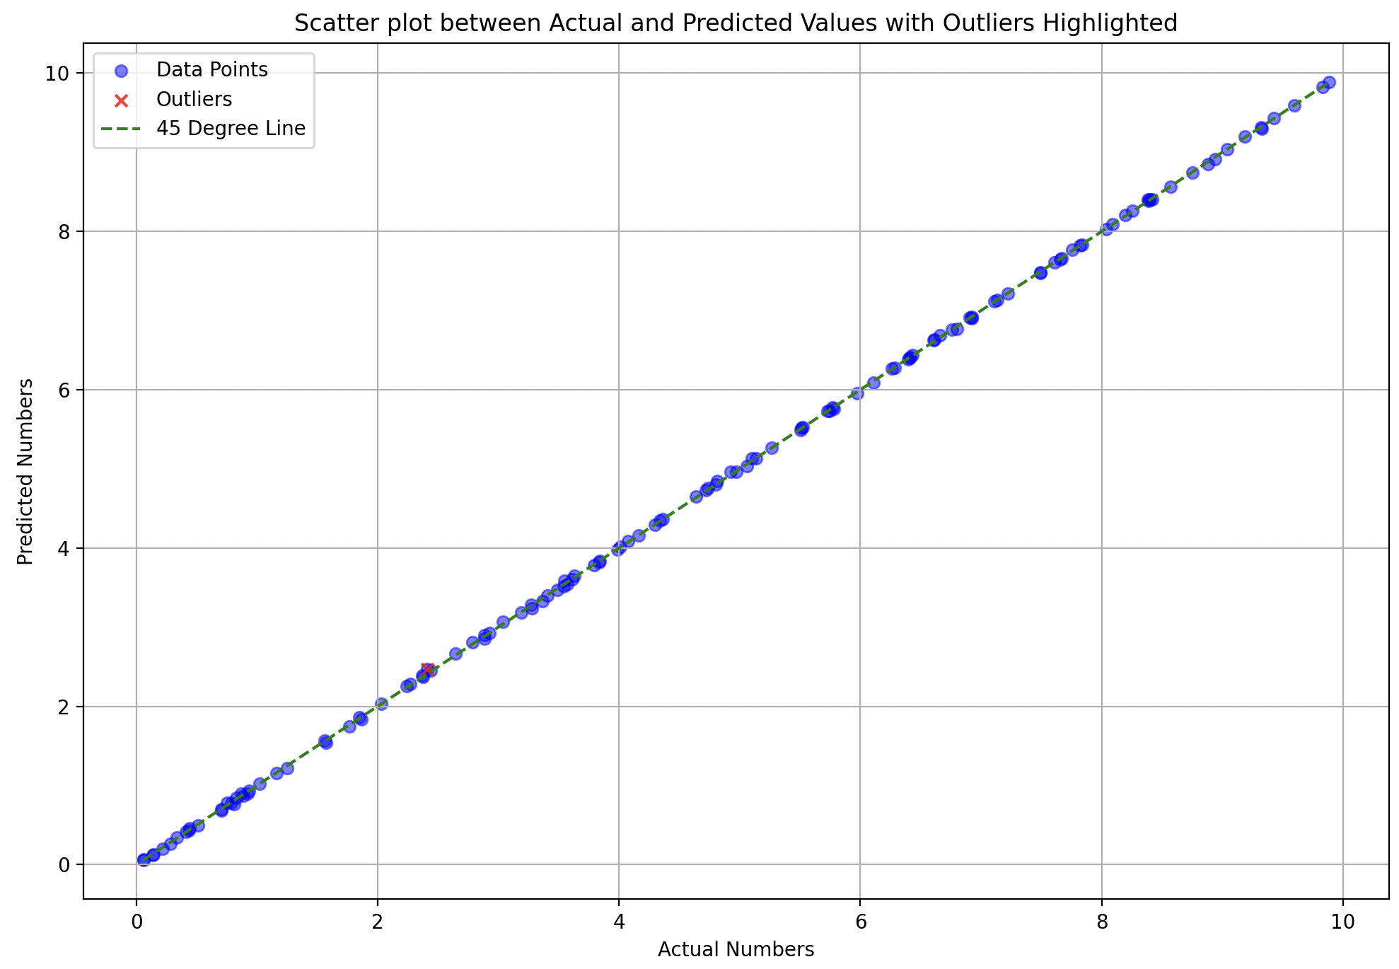
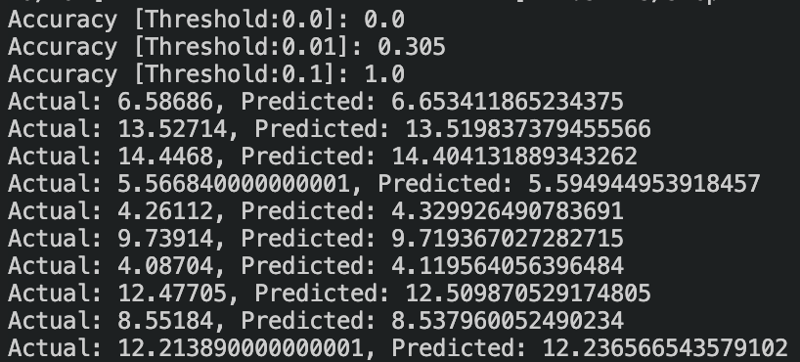
What was wrong?
Train : Test – 40:60

Slide 18
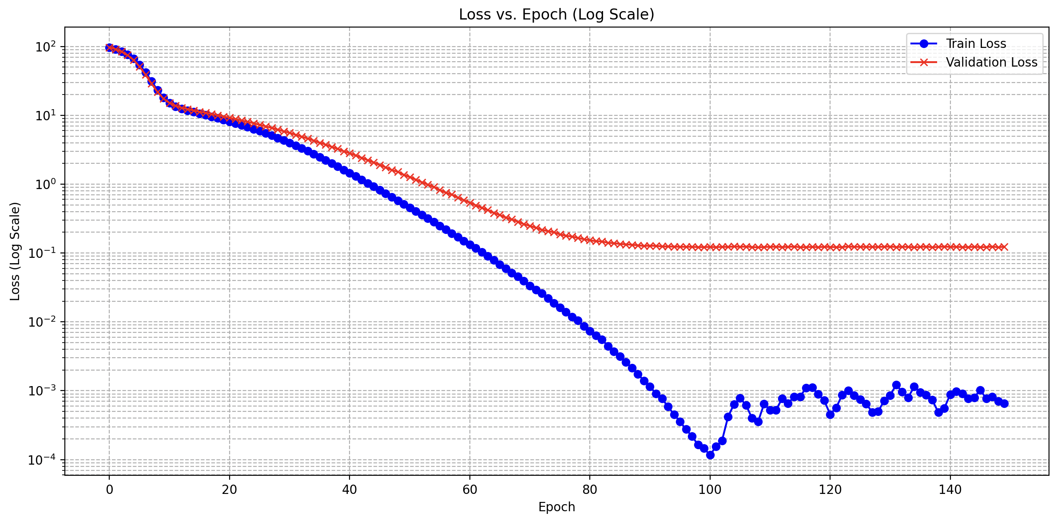
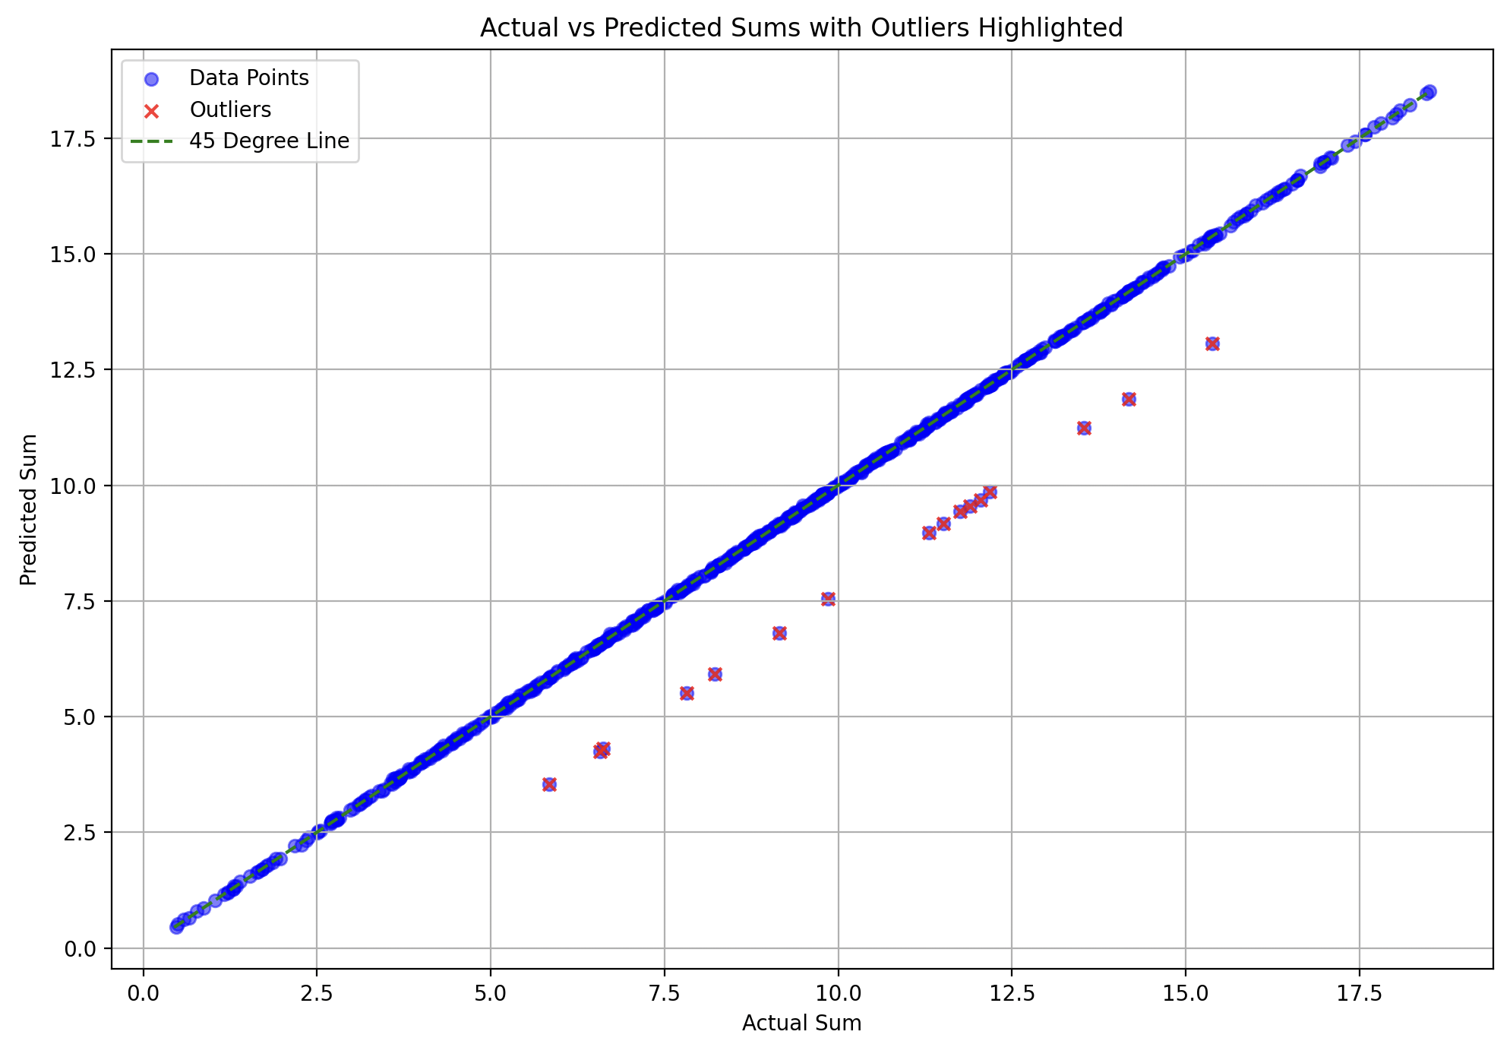
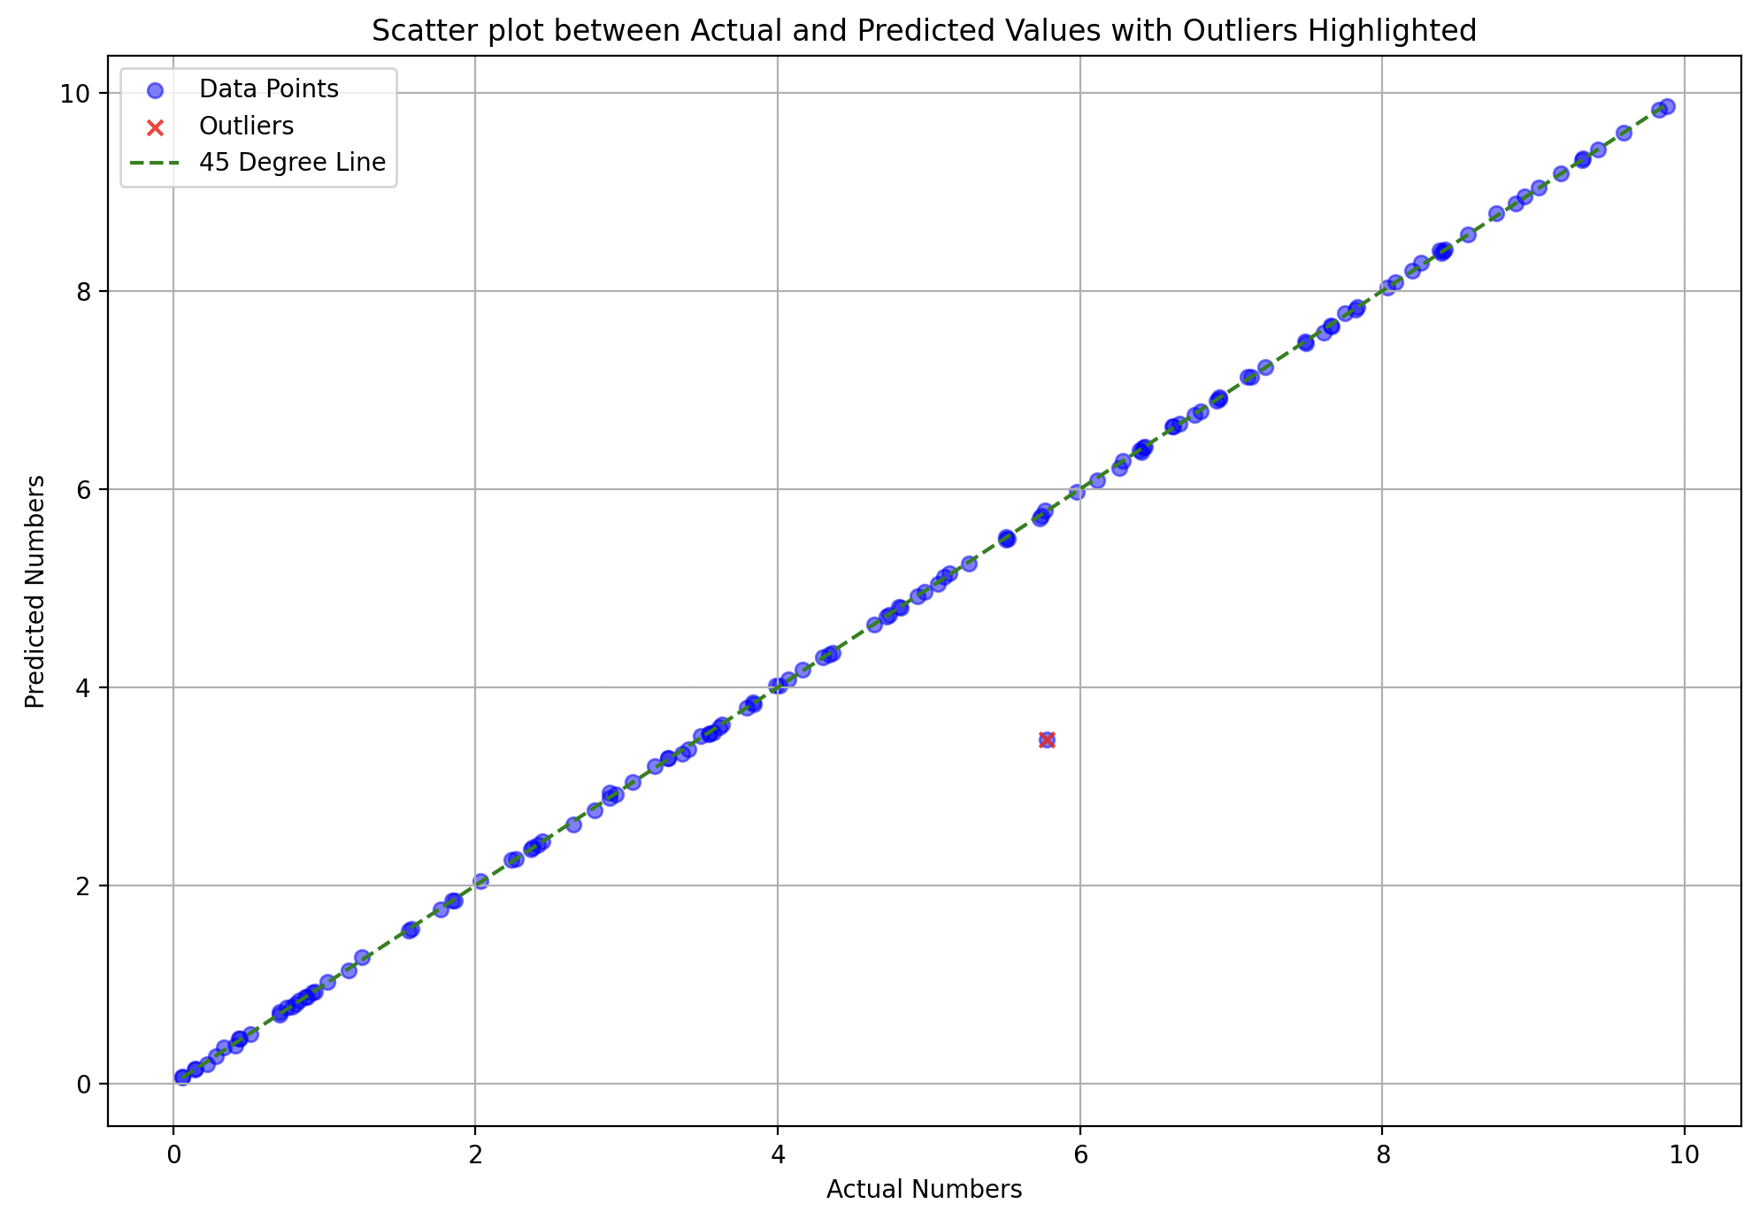

Train : Test – 30:70
not in training

Slide 19

128 (linear one-hot) to 7 (non-linear binary)

Slide 20




Train-Test Split: 35-65 (1000 samples)
Linear
ELU
good attempt to fit

Slide 21




Train-Test Split: 35-65
Activation: ReLU

Slide 22
Things to try
Can we work with just a single occurrence of each 7-bit representation in training? i.e., are 64 pairs (covering all 128 numbers) sufficient for training?
‘n-sum’ problem
{A1, A2}¹
{A3, A4}²
..
{A125, A126}⁶³
{A127, A128}⁶⁴

Slide 23

5-sum problem

Slide 24




ELU vs ReLU Train-Test Split: 50:50 (1000 samples)
ELU
ReLU
more accurate

Slide 25

10-sum problem

Slide 26






25:75 split (1000 samples)
5-sum
10-sum
10-sum
512 (h1) – 128 (h2)
512 (h1) – 128 (h2)
512 (h1) – 256 (h2)
Test loss: 1.64e-6
Test loss: 0.1851
Test loss: 7.12e-7

Slide 27




15:85 split (1000 samples)
5-sum
10-sum
Train loss:0.27
Train loss:0.73
512 (h1) – 256 (h2)
512 (h1) – 256 (h2)
Test loss: 5.24
Test loss: 14.77

Slide 28

5-sum problem
swish(x) = x * sigmoid(x)

Slide 29

7-bit & 128-bit
0000101 = (0)₅(1)₁(0)₁₂₂ = 5th representation = 5.62437

Slide 30






128-bit one hot vs 7-bit binary
1024 (ReLU) - 512 (h1, ReLU) - 256 (h2, ReLU) - out
1024 (ReLU) - 512 (h1, ReLU) - 256 (h2, ReLU) - out
2048 (ReLU) - 1024 (h1, ReLU) - 512 (h2, ReLU) - out
15 Train: 85 Test

Slide 31
7 bit binary 128 bit one-hot ?
encoder-decoder ?

Slide 32

Encoder-Decoder 7 bit binary 128 bit one-hot
[0000100]
7-bit representation
Encoder
Decoder
[00010000…0]
128-bit one hot representation

Slide 33
Thought
128-bit binary (Number 1)
7-bit binary (Number 2)
sum
sum
128-bit one hot
(Number 2)
7-bit one hot
(Number 1)
7-bit binary (Number 1)
7-bit binary (Number 2)
sum
sum
128-bit one hot
(Number 2)
128-bit one hot
(Number 1)
All the pairs have the same sum value!

Slide 34
What’s wrong?
Less data to train?
Overfits training set and hence poor performance on testing set
To do: Re-try inserting the encoder-decoder (7 to 128) block in the 5-sum problem
Thought:
7-bit binary (Number 1)
7-bit binary (Number 2)
?
sum
sum
128-bit one hot
(Number 2)
128-bit one hot
(Number 1)

Slide 35



128-bit one hot to 7-bit binary
Batch size = 1
Step LR decay (initial LR = 1.0e-4)
Decay = 0.4
Split = 80-20
Loss function = BCE
Test Loss = 1.0261
Training Loss = 2.42e-6

Slide 36

Autoencoder Approach
Input 128-bit representation (X)
Batch size = 1
Step LR decay (initial LR = 1.0e-4)
Decay = 0.5
Split = 80-20
Loss function = BCE
128-bit one-hot encoded into 7-bit latent representation (y1)
Encoder Loss = 0.2818
Test Loss = 0.1209
Training Loss = 0.0803
Compute encoder loss (with ground 7-bit representation) (y)
Using the 7-bit latent representation, reconstruct 128-bit representation (X1)

Slide 37



Slide 38

Back to summation problem
128-bit one hot performs good with linear regression
What if we transform 7-bit to 128-bit and proceed?
encoder
decoder

Slide 39
128-bit one hot vs 7-bit binary
1024 (ReLU) - 512 (h1, ReLU) - 256 (h2, ReLU) - out
1024 (ReLU) - 512 (h1, ReLU) - 256 (h2, ReLU) - out
2048 (ReLU) - 1024 (h1, ReLU) - 512 (h2, ReLU) - out
15 Train: 85 Test

Slide 40





5-sum problem (7-bit binary^{new})
Total trainable parameters: 658433
Test Loss: 0.00106
Split: 15:85 (train: test) 1000 Samples
sums
individual

Slide 41
60-sum problem (7-bit binary)
60 inputs
Input (60 X 7) → (60 X 128) → (60 X 1024) → (60 X 512) → 1

Slide 42



60-sum [01-99 split, 30000 samples]
Total trainable parameters: 658433
Test Loss: 2.3626
Split: 01:99 (train: test)
Training time: 15h
Training samples: 300
Testing samples: 29700

Slide 43




60-sum [10-90 split, 30000 samples]
Total trainable parameters: 658433
Test Loss: 7.02e-05
Split: 10:90 (train: test)
Training time: 2h (early stopping)
Training samples: 3000
Testing samples: 27000

Slide 44
A₁
CONV
POOL
L
I
N
E
A
R
R
e
L
U
L
I
N
E
A
R
R
e
L
U
A₂
O
U
T
BOND
(a)
(b)
(c)
(d)

